Slide 1


Using Water
Wisely
Water/LKS2/Geography

Slide 2
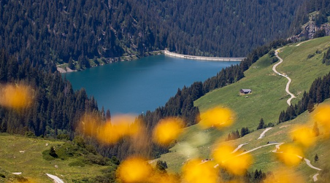
Where Does Water Come From?
Collection
Water comes from rivers, lakes, reservoirs or underground sources. These are called water sources.

Slide 3
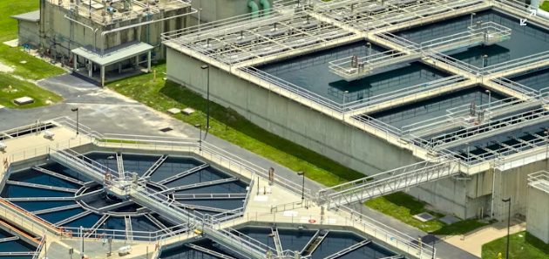
Where Does Water Come From?
Cleaning (Treatment)
The water is taken to a water treatment plant, where it is cleaned to remove dirt, germs and chemicals. This makes it safe to drink.

Slide 4
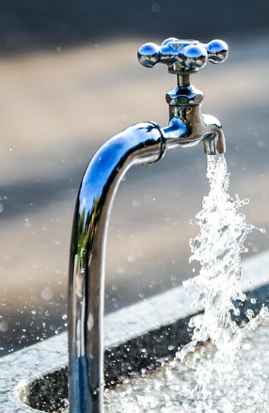
Where Does Water Come From?
Pipes and Pumps
Clean water travels through a network of pipes. Pumps help push the water through the pipes to reach homes, schools and businesses.

Slide 5
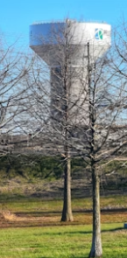
Where Does Water Come From?
Storage
Sometimes water is stored in water towers or underground tanks before it is needed.

Slide 6
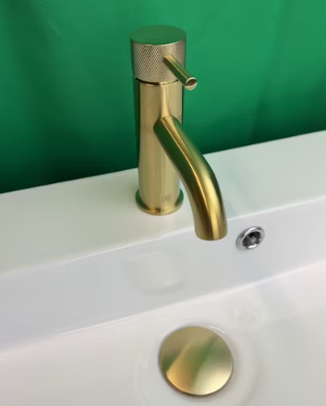
Where Does Water Come From?
Into Our Homes
When you turn on a tap, water flows out because it’s been delivered through this whole system.

Slide 7
Water Safari
Where can you find water in your school?
Where would you go to get water? Look around your school and see if you can find all the places that the pipes bring water into the building. It could be a sink, a machine that uses water or even something that contains water. Aim for 5 different things.
Fill in the first column of your sheet.

Slide 8
Water Safari
How is water used in your school?
Look at each of the locations you have found on your sheet. In your group, discuss what the water is used for – keeping clean, cooking, getting rid of waste etc.
Fill in the second column of your sheet.

Slide 9
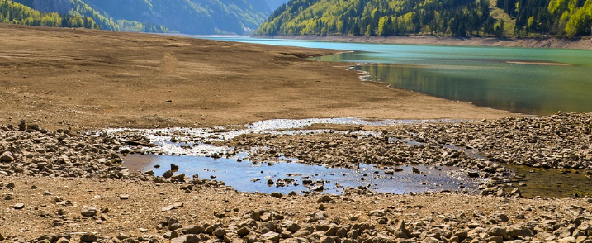
Water Safari
There’s plenty of water?
We use a lot of water in school and at home and are used to being able to turn on a tap at any time.
Unfortunately, water is not always that plentiful, sometimes, when the weather has been dry, water sources such as reservoirs begin to dry up. Climate change means that this is happening more and more often.
We need to be careful of how much water we use so there is still plenty to go round.

Slide 10
Don’t Waste Water!
The average person spends 8 minutes in the shower, using about 20 litres of water — that’s enough to fill 2 buckets!
A toilet with a leak can waste 200–400 litres of water every day — that’s as much as a whole family might use in one day!
Leaving the tap on while brushing your teeth can waste 6 litres per minute. Turning it off saves water and helps the planet.
The average UK roof can collect enough rain to fill 450 water butts a year — perfect for watering gardens without using tap water.
South West Water uses specially trained dogs to sniff out leaks underground — how cool is that?
Turning off the tap while brushing your teeth can save 8,760 litres of water a year — that’s enough to fill a small swimming pool.

Slide 11
Water Safari
How can you save water in your school?
Look at each of the locations you have found on your sheet. In your group, discuss how you might be able to save some of the water you use.
Remember: you need to be safe and hygienic, not washing your hands is not an option!!
Fill in the third column of your sheet.

Slide 12
Make a Poster
Encourage your friends to save water.
Choose one of the locations you have been talking about. Using your ideas for saving water there, design a poster encouraging people to think about saving water.
Features of a Poster
Short, snappy phrases/sentences
An eye-catching layout
A catchy slogan
Attention grabbing pictures
A final reminder of the message

