Slide 1


What is a Good Steward?
Waste/LKS2/RE

Slide 2
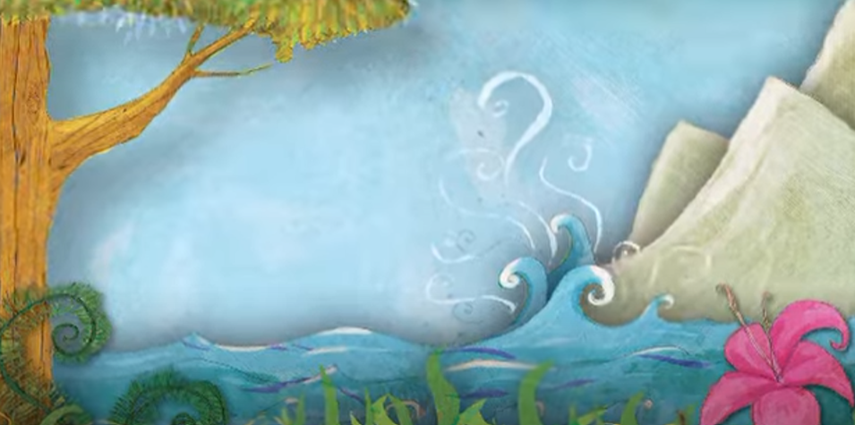
The Creation Story
This is the story that Christians (and Jews and Muslims) tell each other to explain how the World was made. You can find it in the first book of the Bible – Genesis.

Slide 3
Why did God create people?
In this story, God tells us one of the reasons why He made people, this is how one translation of the bible puts it.
God spoke: “Let us make human beings in our image, make them reflecting our nature So they can be responsible for the fish in the sea, the birds in the air, the cattle, And, yes, Earth itself, and every animal that moves on the face of Earth.”
Genesis 1:26-27

Slide 4
What do Christians mean by stewardship?
Christians believe that part of the reason why human beings were put on Earth by God, was to look after his creation. They call this stewardship. That means that we are responsible for the Earth and all that is on it.
Have we been good stewards of the planet?
Talk to your partner

Slide 5
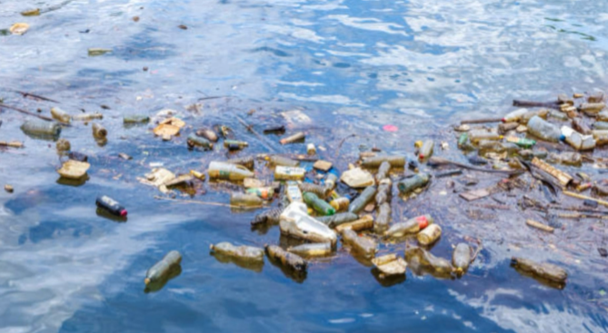
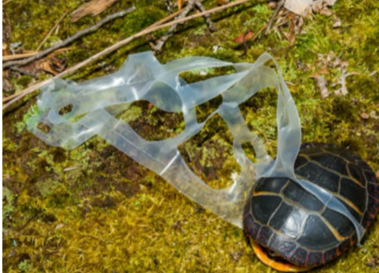
How well have we done?
How does these pictures make you feel?
How do you think they makes God feel?
Talk to your partner

Slide 6
So what can we do?
Have a look on your classroom floor, is there anything there that shouldn’t be?
Is there anything that should be in the bin?
Disposing of our rubbish properly keeps it from spoiling God’s creation.
But does it all belong in the bin?
Talk to your partner

Slide 7
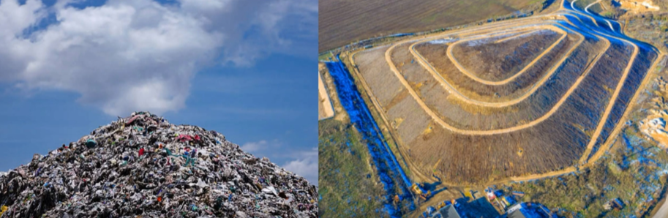
What happens to our rubbish?
Much of the rubbish we put in the bin goes to a landfill site like this, where it is buried.
Is that good for the Earth?

Slide 8

What needs to happen to our rubbish?
Talk to your partner
Partner 1 – Tell your partner three things that can be recycled.
Partner 2 – Tell your partner one they haven’t mentioned.
Share your ideas with your class

Slide 9
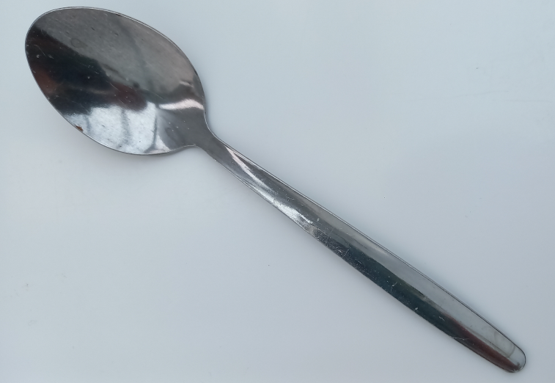
Write a prayer
Finally, we are going to write a prayer.
Have you ever heard of a teaspoon prayer?
Thanks
Sorry
Please
What part of creation would you particularly like to thank God for? Animals? Plants? The sea?
What do you need to say sorry for? Have you ever left a mess or
walked past a piece of rubbish without putting it in the bin?
What would you like God to help with? Is there someone or something you would particularly like Him to look after?

