Slide 1


What is “Art in Nature”?
School Grounds/LKS2/Art

Slide 2
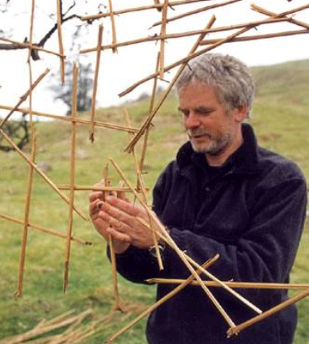
Andy Goldsworthy
Andy Goldsworthy OBE is a British artist. He is known for his work in sculpture and photography. Andy is an environmentalist and this is reflected in the nature-based aspect of much of his work.

Slide 3
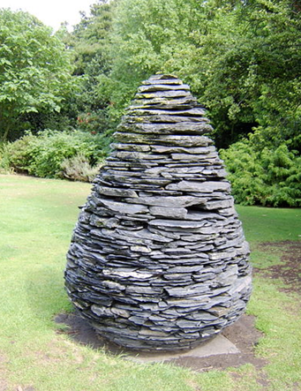
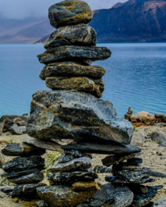
Andy Goldsworthy
Andy describes his art as working “with nature as a whole”. His sculptures are often made up of stones, twigs, flowers, mud, snow and icicles. Many of Andy’s sculptures are created on the site where the objects are found. This is called land art or environmental art.

Slide 4
Art in Nature
Like sand sculptures on a beach, not all of Andy’s art is permanent. He records a lot of his work through photography.
Here are some ideas for Art in Nature, think about lines, spirals and shapes. How will you fill the shapes? Do you want to make a picture or simply create a pattern?
What can you create?

Slide 5
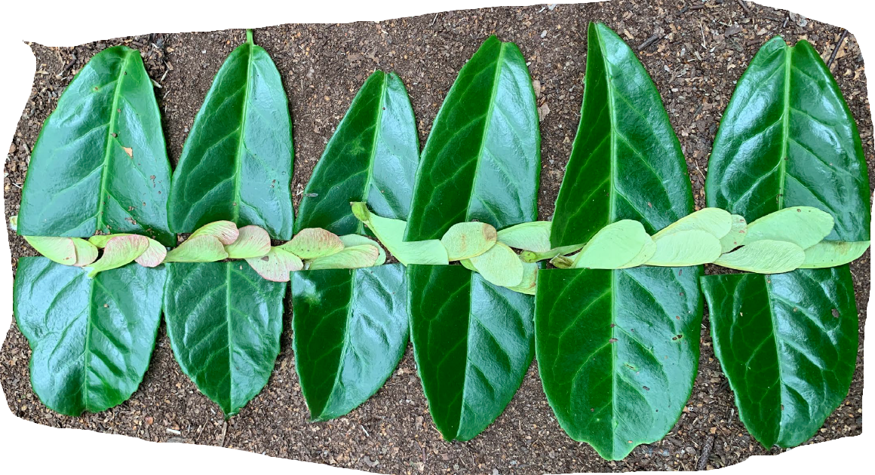
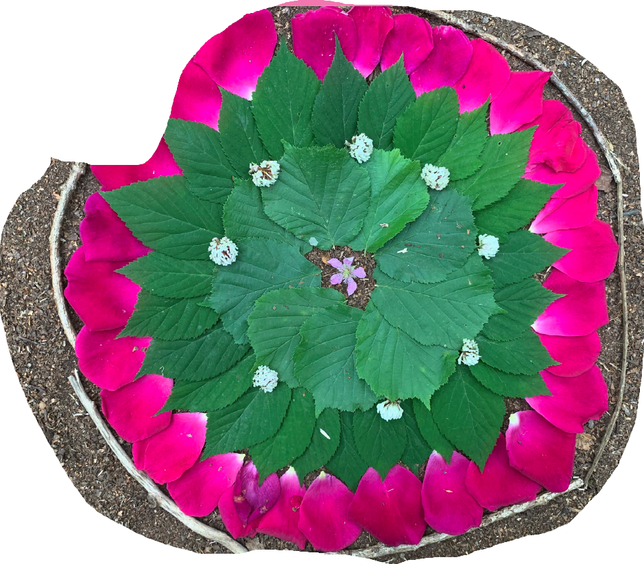
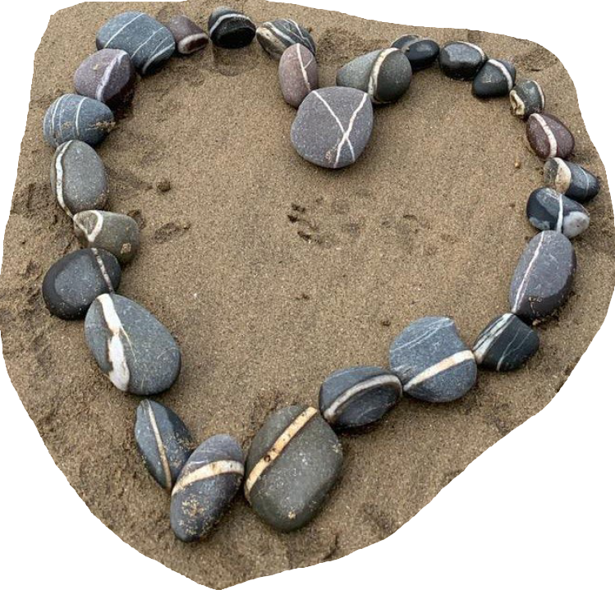
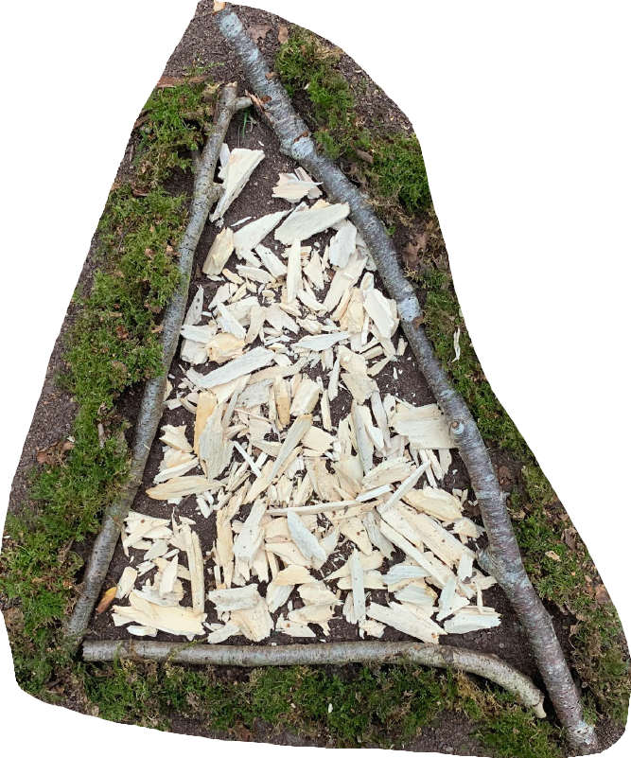
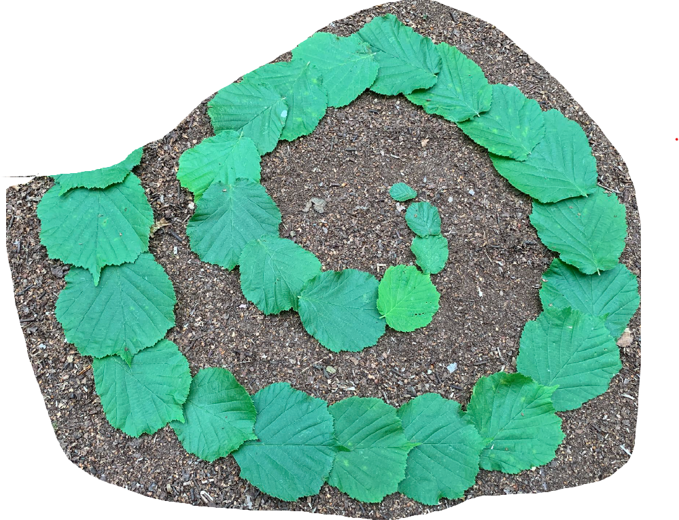
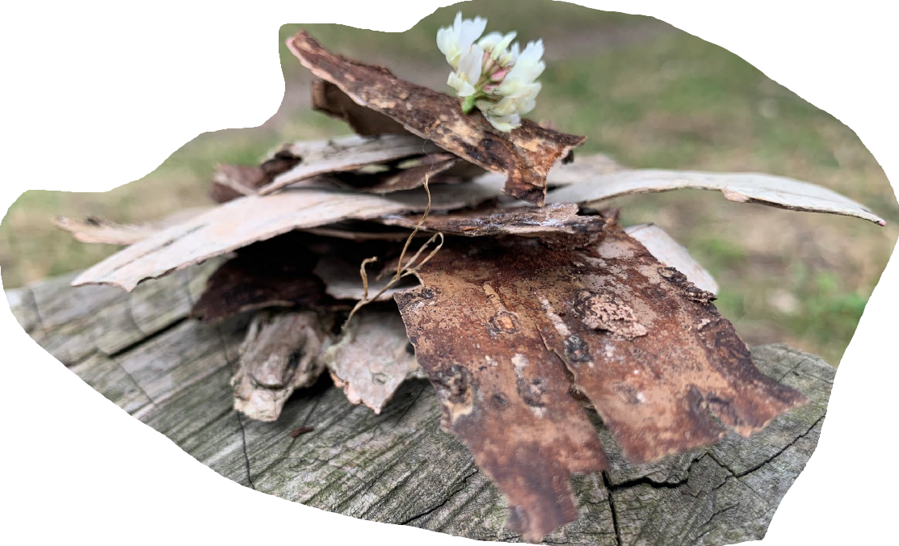












































Art in Nature

Slide 6
Art in Nature
You are going to go out into your school grounds, start by collecting some natural materials, you should only pick up what is lying around – check with an adult before picking anything from the hedgerow or garden.
Before creating your artwork, think about where you are going to place it – what colour or texture do you want your background?
Don’t forget to photograph your finished work to make a record of it, perhaps you could create a display with your class.

Slide 7
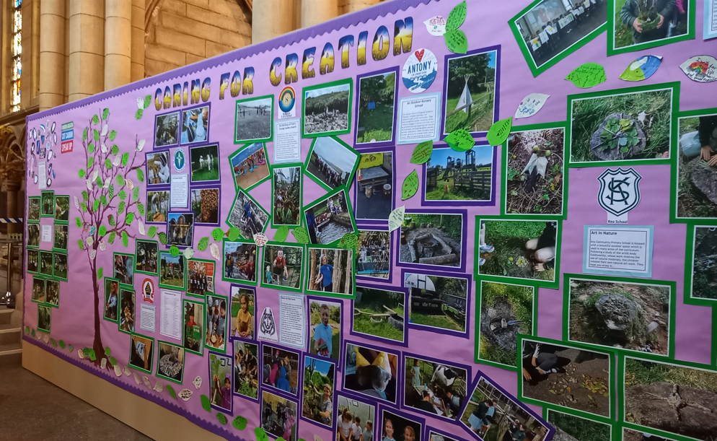
Art in Nature
Art in Nature work on display in Truro Cathedral as part of the Caring for Creation Exhibition by Cornish Schools.

