Slide 1


The Problem
with Litter
Litter/LKS2/PSHE

Slide 2
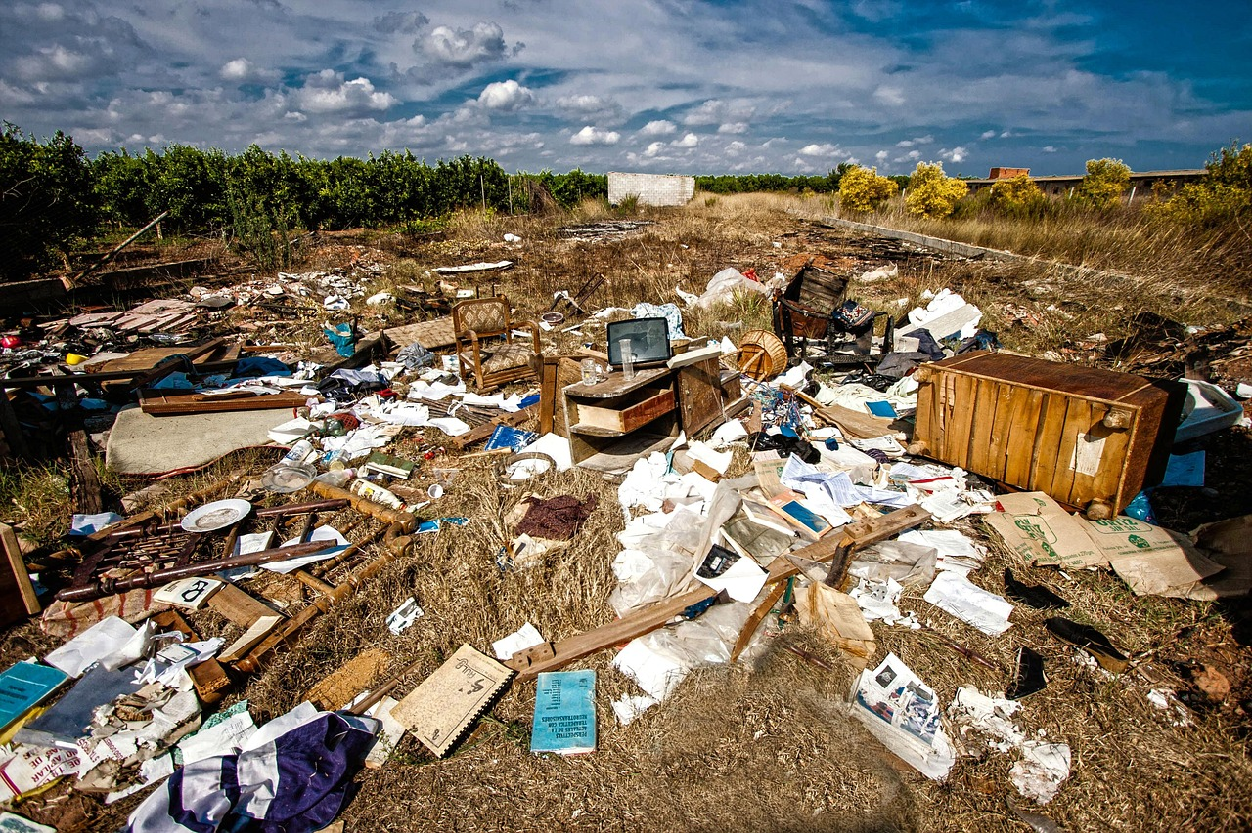
What is Waste?
What can you see in the picture?

Slide 3
What is Waste?
Waste is any material or objects that are no longer wanted or usable.

Slide 4
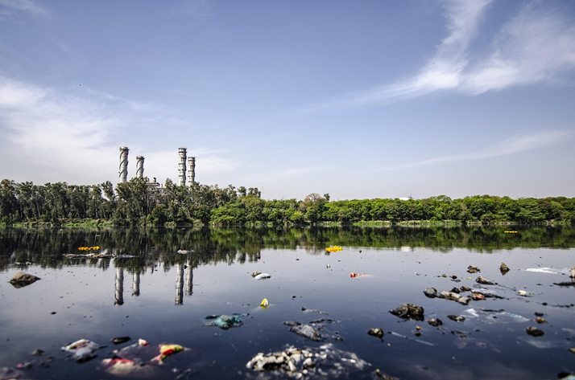
What Harm Can it Do?
Pollution of Land and Water
Litter like plastic bags and wrappers can end up in rivers, lakes, and oceans.
It pollutes water sources and harms aquatic life.
Chemicals from litter can seep into soil and groundwater.

Slide 5
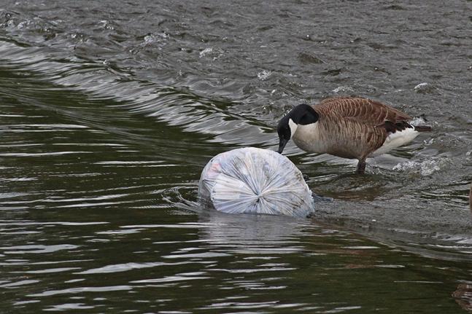
What Harm Can it Do?
Harm to Wildlife
Animals may mistake litter for food and eat it, leading to injury or death.
Birds and marine animals can get tangled in plastic rings or fishing lines.
Sharp objects like broken glass can injure animals.

Slide 6
What Harm Can it Do?
Damage to Ecosystems
Litter disrupts natural habitats and can prevent plants from growing.
It can introduce toxins that affect the balance of ecosystems.
Non-biodegradable waste like plastic stays in the environment for hundreds of years.

Slide 7
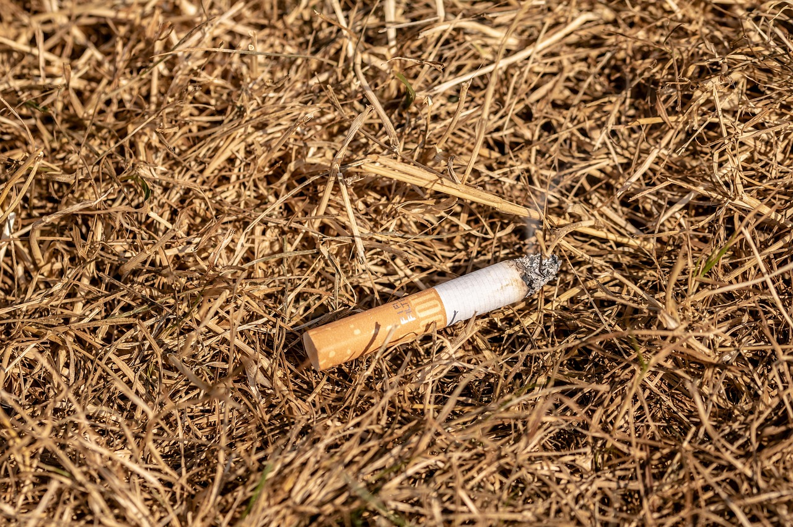
What Harm Can it Do?
Fire Hazards
Discarded items like glass bottles can magnify sunlight and start fires in dry areas.
Cigarette butts can ignite dry grass or leaves.

Slide 8
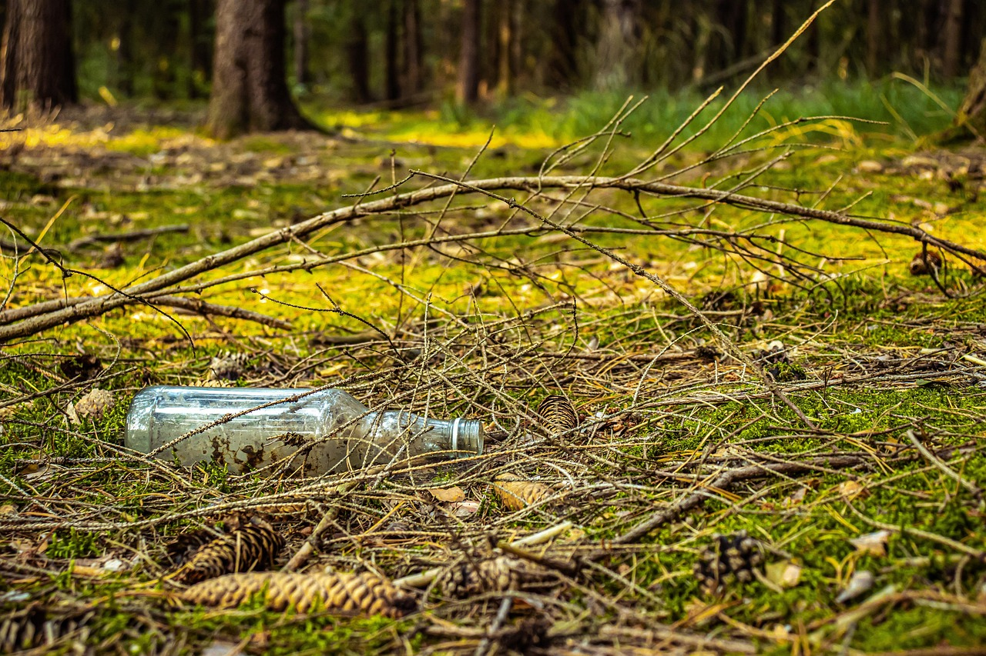
What Harm Can it Do?
Visual Pollution and Community Impact
Litter makes public spaces look dirty and neglected.
It can reduce community pride and discourage tourism or investment.
Cleaning up litter costs the local council money that could be spent elsewhere.

Slide 9

What Can We Do?
Reduce, Reuse, Repurpose, Recycle!
Reduce means to cut down the amount of waste we produce such as only buying what we really need
Reuse means use something as many times as possible such as washing out your empty cola bottle to use as a water bottle for school
Repurpose means to find a different use for something like cutting the legs off jeans that have holes in the knees to make shorts or food waste being turned into compost
Recycle means to convert waste material into new products, like melting down old glass bottles to make new ones.

Slide 10
What Can We Do?
Reduce, Reuse, Repurpose, Recycle!
Click on the recycling logo to learn more

Slide 11
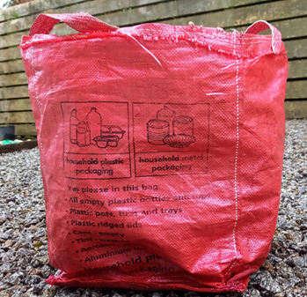
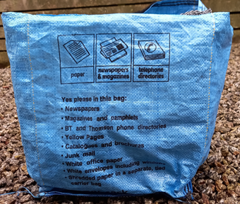
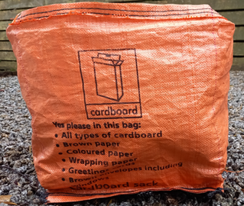
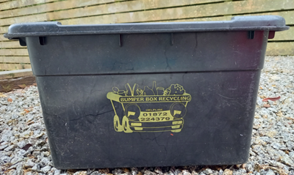
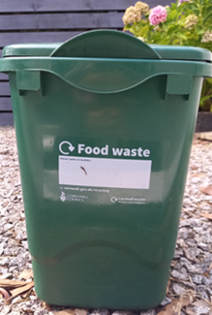
How Do We Recycle?
In Cornwall, our council provides a number of containers to put our recycling in, and it can be very confusing.
How well do you know your bins?

Slide 12
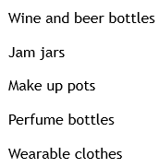
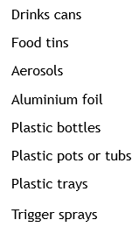
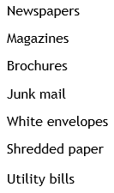
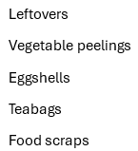
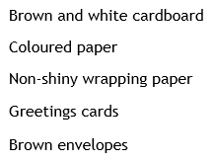
How Do We Recycle?
What goes in each container?

Slide 13
How Do We Recycle?
What goes in each container?

Slide 14
How Do We Recycle?
What goes in each container?

Slide 15
How Do We Recycle?
What goes in each container?

Slide 16
How Do We Recycle?
What goes in each container?

Slide 17
How Do We Recycle?
What goes in each container?

Slide 18
What Can We Do?
You are going to encourage people to sort waste correctly in school.
Tip out the contents of your classroom bin onto a sheet or table covered in newspaper
Wearing gloves, look carefully at the contents – is there anything in there that could be recycled?
If there is, take it out and put it in the recycling container instead.

Slide 19
What Can We Do?
Make a Poster
Make an information poster to go up next to or on the bins around your school
Tell people what should and what shouldn’t go into that bin
Encourage them to recycle correctly.
Features of a Poster
Short, snappy phrases/sentences
An eye-catching layout
A catchy slogan
Attention grabbing pictures
A final reminder of the message

