Slide 1


Why Keep
Fit?
Healthy Living/LKS2/PE

Slide 2
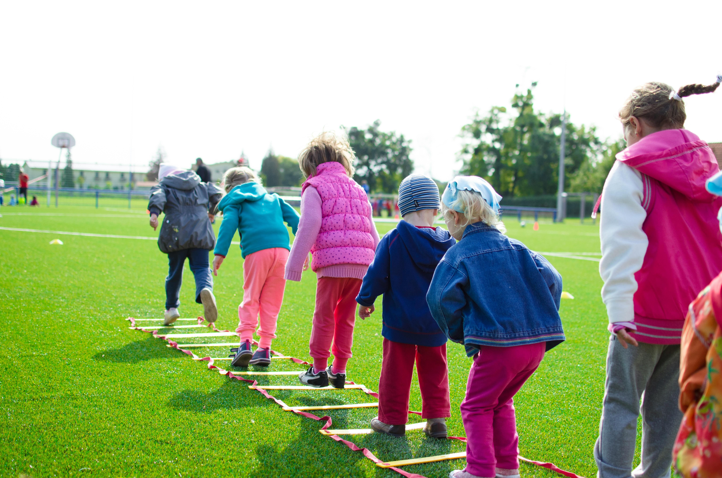
Why Do We Exercise?
Exercise is like giving your body a superpower!
When you run, jump, swim, dance, or play sports, you're helping your body in lots of cool ways:
It makes your muscles and bones strong – like a superhero getting ready for action!
It helps your heart – your heart is a muscle too, and exercise keeps it healthy so it can pump blood all around your body.
It gives you energy – even though you might feel tired after playing, regular exercise actually helps you feel more awake and ready to do fun things.
It helps your brain – moving your body helps you concentrate better in school and feel happier.
It keeps you healthy – it helps your body fight off germs, so you don’t get sick as often.
And the best part? Exercise can be fun!

Slide 3
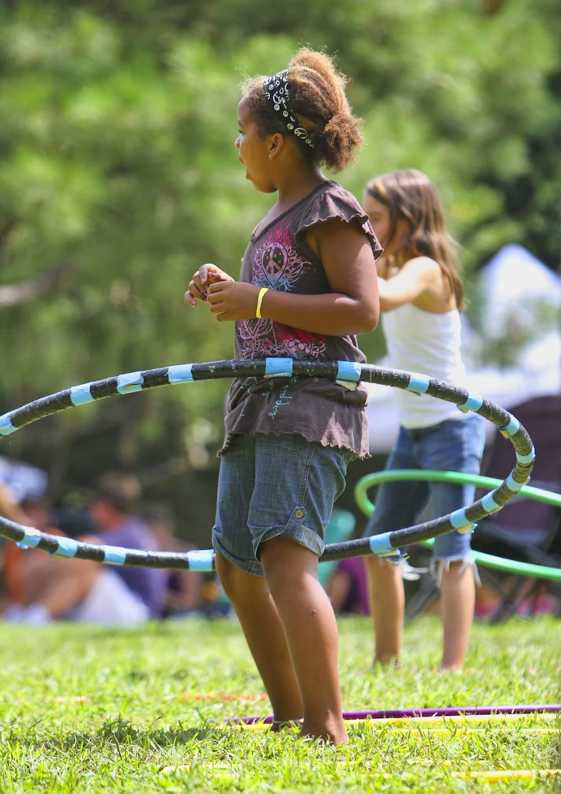
How Can We Exercise?
Today, you are going to be in charge of the PE lesson, designing some quick activities that will help you and your classmates keep fit and healthy.
You may have played with hoops before; they are a piece of equipment that can be used in a variety of ways.
Here are a few ideas:

Slide 4
Games With a Hoop
Can you get the hoop to spin around your waist? You may find you can spin a larger hoop more easily than a smaller one. Once you get the hang of it, try to do other tricks.
Put your hands inside the hoop and keep them in the same position, whilst your feet move around the outside
of the hoop.
Roll an upright hoop along the ground with your hand. How far can you go without the hoop falling down? Find a straight line on the playground, (or draw a chalk line) and try to follow it with the hoop. Add obstacles such as cones to slalom the hoop around.
Lay out some hoops on the ground, with each one a little further away from a throwing line than the one before. Try to get your beanbag into the first hoop. When successful, you
can move onto the second hoop and so on. Score points for varying distances away from the throwing line.
Put your feet inside the hoop and keep them in the same position, whilst your hands move around the outside of the hoop.
Use the hoop just like a skipping rope, holding it vertically in front of your body and then flipping it down toward your feet, jumping over it and bringing it back behind your body and over your head. Try skipping both on the spot and moving around.

Slide 5
How Can We Exercise?
In groups, choose three activities for your session, you can use the ones suggested, or you can invent your own. Work out how many hoops you need and whether you need any other equipment.
Remember that the activity needs to be safe for everyone.
Out in the playground, or in the hall set up your three activities, and make sure everyone in the group knows what to do on all three.
Each group member chooses which activity they will start with, it’s best to have at least 2 people on each one.
Do the activity for three minutes (Ask your teacher to time you) and then change to a different one. Do three minutes on each activity.

Slide 6
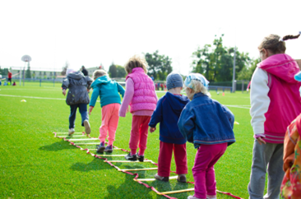
How Can We Exercise?
When each person in the group has done all of the activities, pair up with another group.
Teach them your activities and listen while they explain theirs.
Swap places with them and try each other’s activities for two minutes.
If you have time, you can swap again with a different group.

