Slide 1


Could you write a letter?
Global Citizenship/LKS2/English

Slide 2
Pollution Quiz
We all know that there is a problem with pollution in the ocean, but how big a problem is it? Try answering the following questions with your classmates.
How many pieces of plastic enter the ocean each day?
a) 1 million b) 4 million c) 8 million

Slide 3
Pollution Quiz
We all know that there is a problem with pollution in the ocean, but how big a problem is it? Try answering the following questions with your classmates.
How many pieces of plastic enter the ocean each day?
a) 1 million b) 4 million c) 8 million

Slide 4
Pollution Quiz
How many of the fish caught for human consumption contain plastic?
a) 1 in 3 b) 1 in 7 c) 1 in 10

Slide 5
Pollution Quiz
How many of the fish caught for human consumption contain plastic?
a) 1 in 3 b) 1 in 7 c) 1 in 10

Slide 6
Pollution Quiz
How many times was sewage discharged into UK waterways in 2023?
a) About 200,000 b) About 500,000 c) About 1 million

Slide 7
Pollution Quiz
How many times was sewage discharged into UK waterways in 2023?
a) About 200,000 b) About 500,000 c) About 1 million

Slide 8
Pollution Quiz
What percentage of rubbish found in the sea is made of plastic?
a) 50% b) 65% c) 80%

Slide 9
Pollution Quiz
What percentage of rubbish found in the sea is made of plastic?
a) 50% b) 65% c) 80%

Slide 10
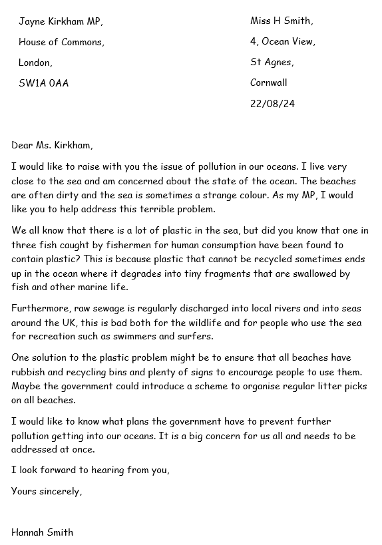
Read this letter

Slide 11
Think about…
Is there any vocabulary you do not understand? How can you find the meaning?
Why has the author written this letter?
What has the author done to engage the reader’s attention?
What is each paragraph about?

Slide 12
Let’s look closer
Recipient’s name and address
Authors name and address
Greeting
Introduction
Why you are writing.
Reasons
Evidence to support your argument. Link with conjunctions.
Solution
Your ideas/What you want your MP to do.
Conclusion
A strong final statement.
Signature

Slide 13
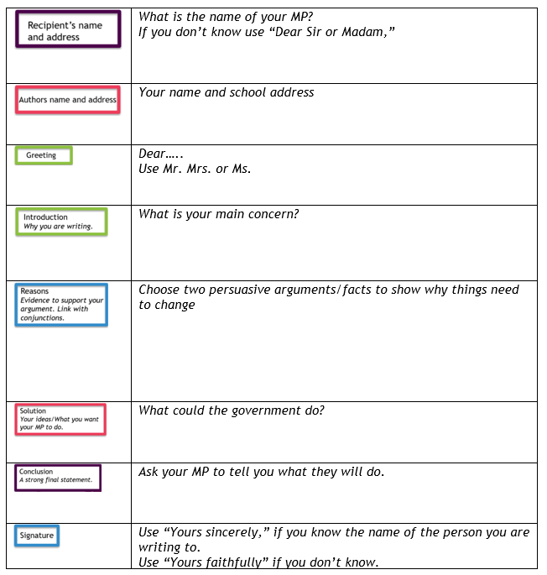
Let’s plan a letter to our MP

Slide 14
Let’s write a letter to our MP
Now use your notes to write your letter.

