Slide 1


Where does Energy Come From?
Energy/LKS2/Geography

Slide 2
What Do We Use Energy For?
How many things can you see in your classroom that need a source of energy to make them work?
See how many you can write down in 60 seconds.

Slide 3
What Do We Use Energy For?
How many things can you see in your classroom that need a source of energy to make them work?
See how many you can write down in 60 seconds.
Compare your list with three other people, can you share your ideas to add three other things to your list?

Slide 4
What Do We Use Energy For?
How many things can you see in your classroom that need a source of energy to make them work?
whiteboard
lights
heaters
ipad
speakers
calculator

Slide 5

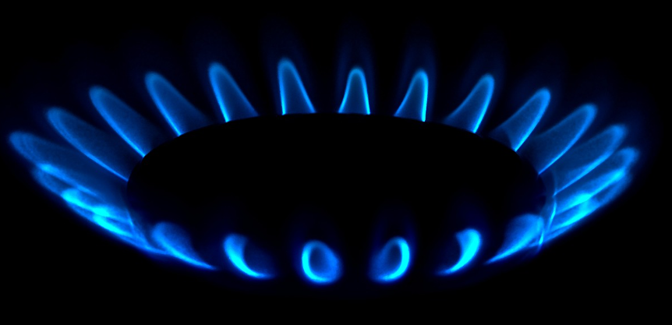
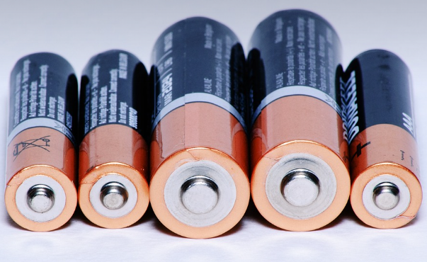
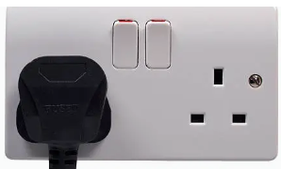
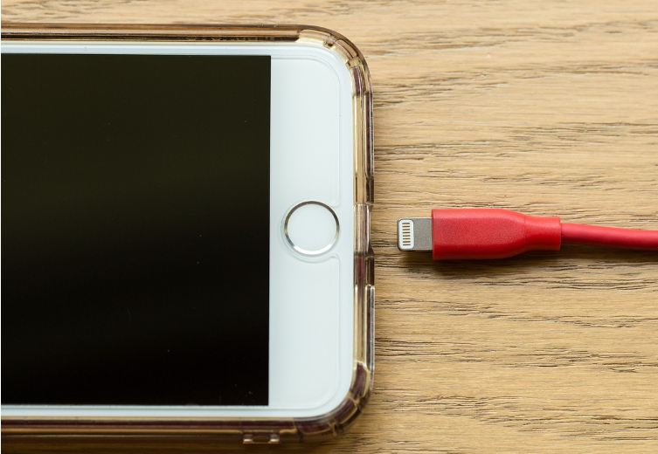
Is All Energy the Same?
Do all the things on your list have the same energy source?

Slide 6
Where does energy come from?
Energy comes from a lot of different sources, have a look at the pictures and see which you recognise.

Slide 7
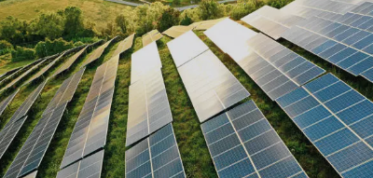
Where does energy come from?
Energy comes from a lot of different sources, have a look at the pictures and see which you recognise.

Slide 8
Where does energy come from?
Solar Energy
Sunlight is converted into energy by solar panels, we often see them in fields or on buildings or houses.

Slide 9
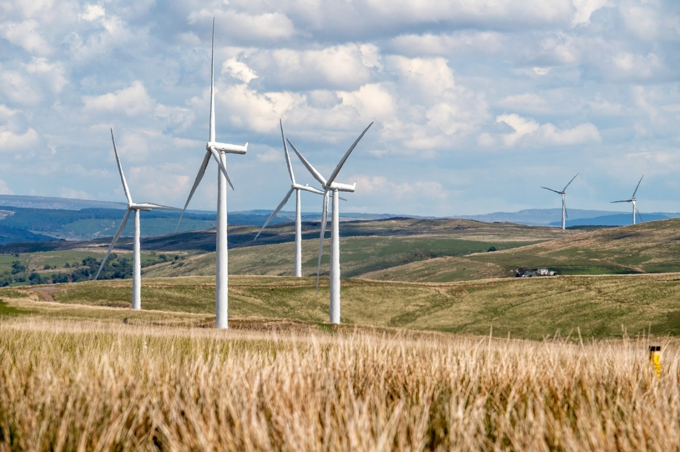
Where does energy come from?

Slide 10
Where does energy come from?
Wind Energy
The power of the wind is converted into energy by wind turbines, we often see these at the top of hills where the wind is strongest.

Slide 11
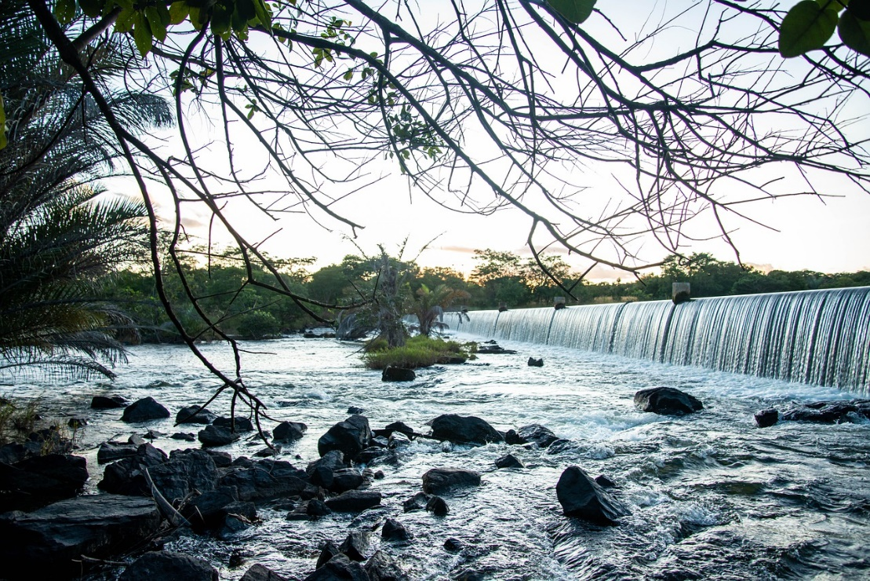
Where does energy come from?

Slide 12
Where does energy come from?
Hydropower Energy
Turbines are used to convert the force of moving water into electricity. This can come from rivers or the sea.

Slide 13
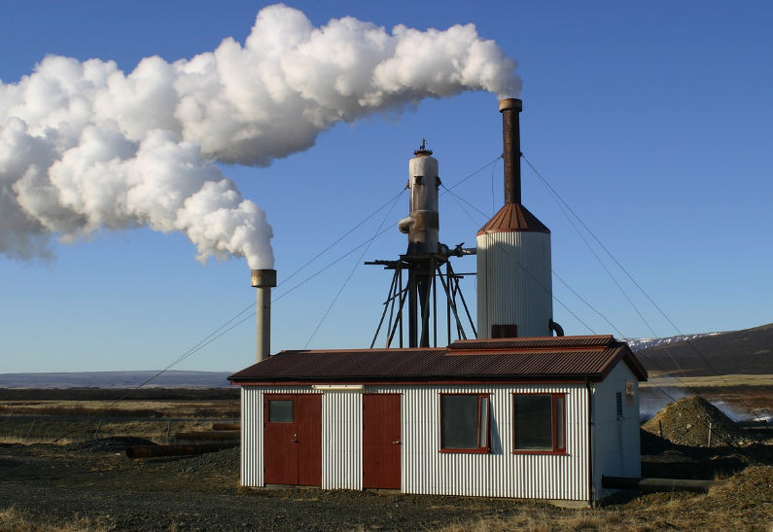
Where does energy come from?

Slide 14
Where does energy come from?
Geothermal Energy
It is very hot under the ground, this heat can be harnessed to produce energy. Work is being done in Cornwall to improve the way this is done and make it more efficient.

Slide 15
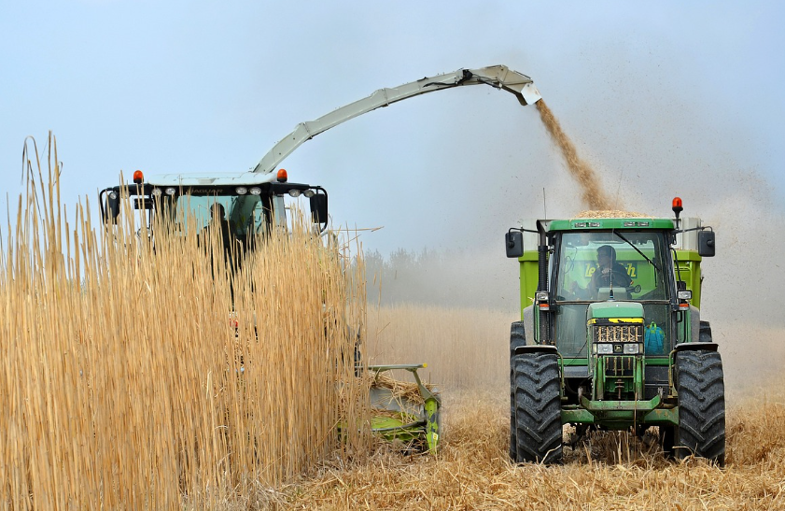
Where does energy come from?

Slide 16
Where does energy come from?
Biomass Energy
Natural material such as scrap pieces of wood, dead trees and unused parts of crops can be burnt to produce energy. You can even burn the gas produced by cow manure to make energy!

Slide 17
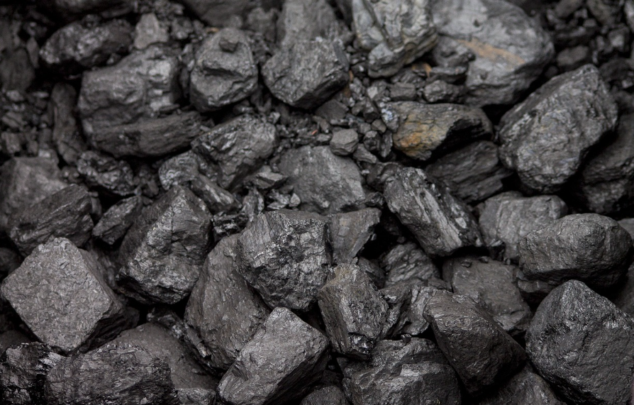
Where does energy come from?

Slide 18
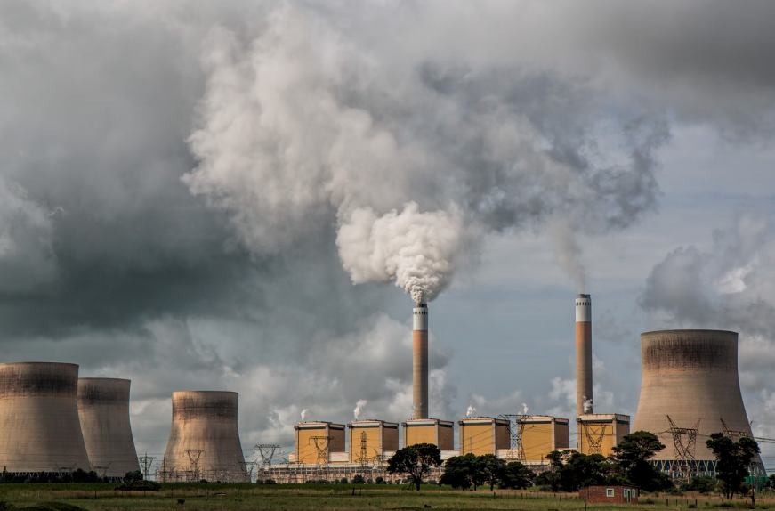
Where does energy come from?
Coal Energy
Coal is burned in power stations to produce energy, this releases carbon dioxide into te atmosphere which is bad for the environment. The coal takes millions of years to form and cannot be replaced.

Slide 19
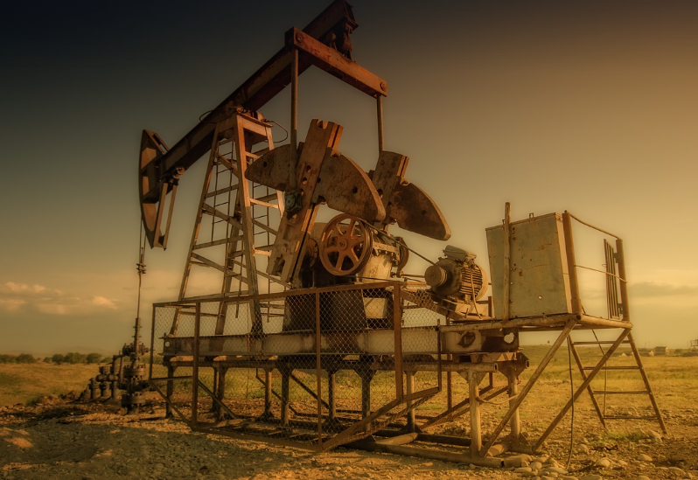
Where does energy come from?

Slide 20
Where does energy come from?
Oil Energy
Oil is found underground, it is used in homes to create heat for hot water and radiators. It is also used to fuel vehicles and machinery. Eventually, the oil will run out.

Slide 21
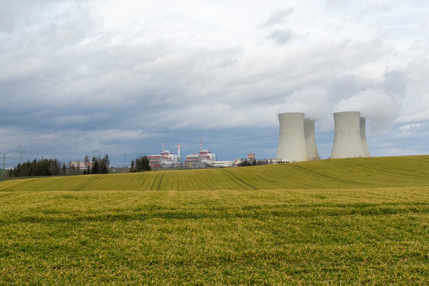
Where does energy come from?

Slide 22
Where does energy come from?
Nuclear Energy
Nuclear power stations use uranium as fuel to make electricity, uranium comes out of the ground. This type of power does not pollute the atmosphere, but it does produce dangerous waste that needs to be disposed of carefully.
Notes:
Nuclear energy is generally not considered renewable because it relies on finite resources like uranium, which can be depleted. However, it is a low-carbon energy source, meaning it doesn’t produce greenhouse gases during operation, making it environmentally friendly in terms of emissions.
Some people argue that with advancements in technology, such as using thorium, nuclear energy could become more sustainable. But as of now, it doesn’t fit the traditional definition of renewable energy, which includes sources like solar, wind, and hydro that are naturally replenished.

Slide 23
Where does energy come from?

Slide 24
Where does energy come from?
Gas Energy
Natural gas is found underground, we use it to cook with and to heat water and radiators. It takes millions of years for gas to form underground, so, like oil and coal, it will also run out one day.

Slide 25
So which should I choose?
Renewable Energy
Renewable energy comes from natural resources that are naturally replenished, such as sunlight, wind and waves.
Non-Renewable Energy
Non-renewable energy comes from natural resources that are not naturally replenished, such as oil and coal.

Slide 26
So which should I choose?
Renewable Energy
Renewable energy comes from natural resources that are naturally replenished, such as sunlight, wind and waves.
Non-Renewable Energy
Non-renewable energy comes from natural resources that are not naturally replenished, such as oil and coal.
Can you name the sources of energy and sort them into renewable and non-renewable sources?

Slide 27
Why don’t we all just use renewable sources for our energy?
Renewable Energy
Renewable energy is tricky to store and is dependant on whether the wind is blowing or how sunny it is, for example. Also, some people do not like to see wind turbines or solar panels in the countryside.
Non-Renewable Energy
Non-renewable energy is much easier to store. They also used to be the cheaper way of producing energy, although this is changing rapidly as they become more expensive.

Slide 28
Why don’t we all just use renewable sources for our energy?
Renewable Energy
Renewable energy is tricky to store and is dependant on whether the wind is blowing or how sunny it is, for example. Also, some people do not like to see wind turbines or solar panels in the countryside.
Non-Renewable Energy
Non-renewable energy is much easier to store. They also used to be the cheaper way of producing energy, although this is changing rapidly as they become more expensive.
What do you think we should use?

Slide 29
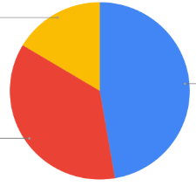
How much renewable energy do we use?
This pie chart shows where energy used in the UK came from in 2024. Three quarters of all renewable energy comes from the wind.
Nuclear
16.9%
Renewable Sources
40.6%
Natural Gas
35.1%
Other Sources or Imports
7.4%
https://www.energydashboard.co.uk/live

Slide 30
Where are the wind farms?
Things to try
Use an Ordinance Survey map, such as Bing Maps, to find wind farms in Cornwall. What do you think the OS symbol for a wind farm looks like?
Start by zooming in on Carland Cross to see what a wind farm looks like on a map. Are there any wind farms near your school?
Look at the contour lines near the wind farms. These show the height of the land –what do you notice?
You can look at renewable energy maps to see how many wind farms there are in Cornwall.

Slide 31


Where are the wind farms?
Things to try
Use an Ordinance Survey map, such as Bing Maps, to find wind farms in Cornwall. What do you think the OS symbol for a wind farm looks like?
Start by zooming in on Carland Cross to see what a wind farm looks like on a map. Are there any wind farms near your school?
Look at the contour lines near the wind farms. These show the height of the land –what do you notice?
You can look at renewable energy maps to see how many wind farms there are in Cornwall.

