Slide 1


Carnival of the Animals
Biodiversity/LKS2/Music

Slide 2
Animal Facts
The World is an amazing place, home to millions of species of animals. How much do you know about animals?
What is the biggest animal in the world? A) Elephant B) Giraffe C) Blue Whale D) Great White Shark
✅ Answer: C) Blue Whale

Slide 3
Animal Facts
The World is an amazing place, home to millions of species of animals. How much do you know about animals?
What is the biggest animal in the world? A) Elephant B) Giraffe C) Blue Whale D) Great White Shark
✅ Answer: C) Blue Whale

Slide 4
Animal Facts
The World is an amazing place, home to millions of species of animals. How much do you know about animals?
How many legs does an insect have?
A) 4
B) 6
C) 8
D) 10
✅ Answer: B) 6

Slide 5
Animal Facts
The World is an amazing place, home to millions of species of animals. How much do you know about animals?
How many legs does an insect have?
A) 4
B) 6
C) 8
D) 10
✅ Answer: B) 6

Slide 6
Animal Facts
The World is an amazing place, home to millions of species of animals. How much do you know about animals?
Which of these animals is a mammal?
A) Crocodile
B) Dolphin
C) Parrot
D) Lizard
✅ Answer: B) Dolphin

Slide 7
Animal Facts
The World is an amazing place, home to millions of species of animals. How much do you know about animals?
Which of these animals is a mammal?
A) Crocodile
B) Dolphin
C) Parrot
D) Lizard
✅ Answer: B) Dolphin

Slide 8
Animal Facts
The World is an amazing place, home to millions of species of animals. How much do you know about animals?
What do we call animals that live both in water and on land?
A) Mammals
B) Amphibians
C) Reptiles
D) Birds
✅ Answer: B) Amphibians

Slide 9
Animal Facts
The World is an amazing place, home to millions of species of animals. How much do you know about animals?
What do we call animals that live both in water and on land?
A) Mammals
B) Amphibians
C) Reptiles
D) Birds
✅ Answer: B) Amphibians

Slide 10
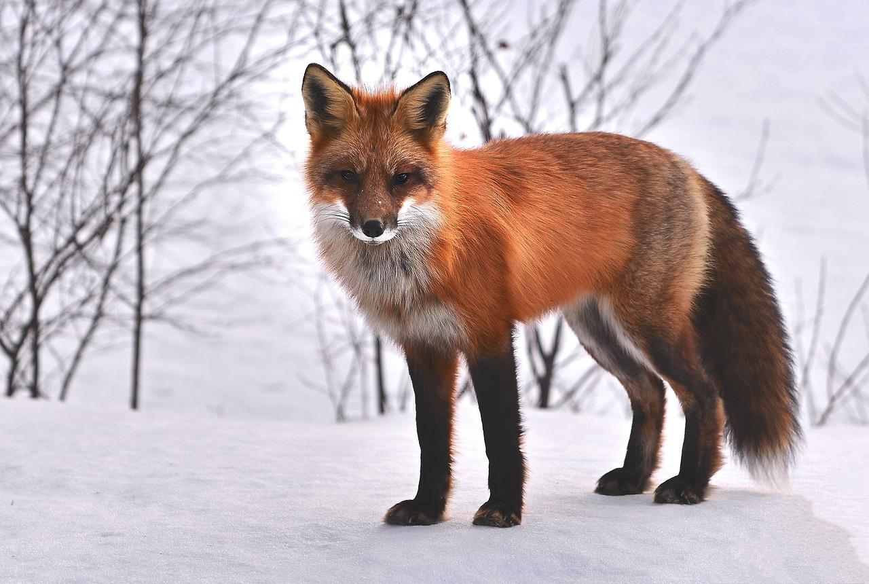
Animal Facts
Do you know any other animal facts?
What is your favourite animal?

Slide 11
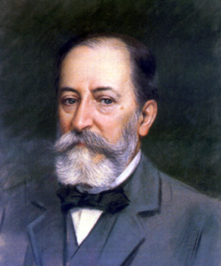
Saint Saëns
Camille Saint-Saëns (say it like: San-Sohn) was a famous French composer who lived a long time ago—he was born in 1835 and loved music from the time he was a little boy.
By the time he was just 5 years old, he could play the piano really well, and by 10, he was already performing in concerts! He was kind of like a music superhero.

Slide 12

Saint Saëns
One of his most fun and famous pieces is called "The Carnival of the Animals." It’s like a musical zoo! Each part of the music sounds like a different animal—there’s a hopping kangaroo, a slow elephant, and even a graceful swan.
Saint-Saëns wrote music that could be exciting, beautiful, and even a little bit silly. He wanted people to enjoy music and feel something special when they listened.

Slide 13
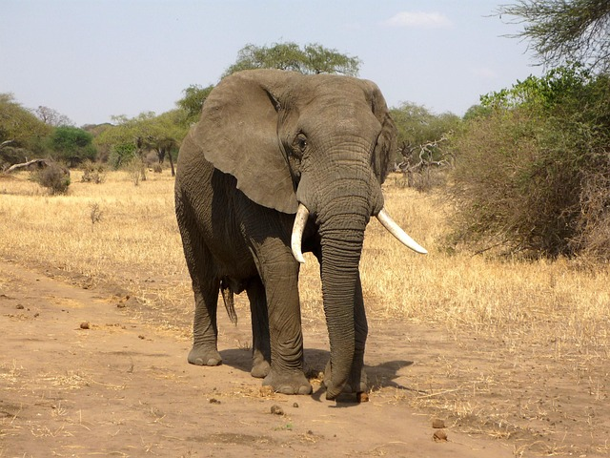
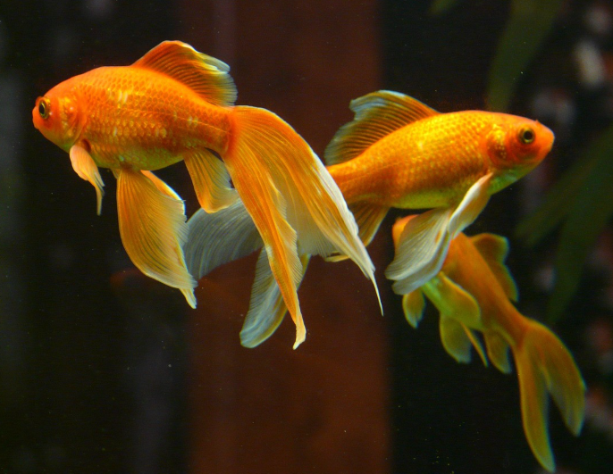
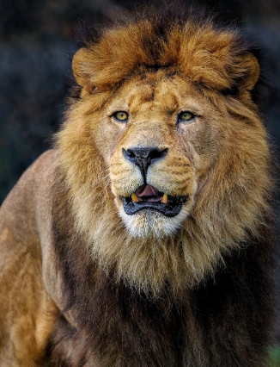
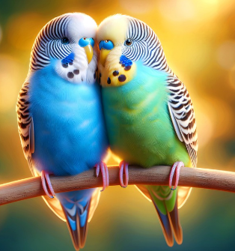
Carnival of the Animals
Let’s listen to some of the Carnival of the Animals, Can you identify which animal is which?
?

Slide 14
Carnival of the Animals
Let’s listen to some of the Carnival of the Animals, Can you identify which animal is which?
Just as the animal kingdom is diverse, so each part of the Carnival of the Animals is different, how does the composer make the music describe the animals?

Slide 15
Carnival of the Animals
Now it’s your turn!
In your music groups, pick one of the animals. You are going to compose a piece of music about that animal – think about how the animal moves, what it sounds like and what it looks like. Think about which instruments will work best.

Slide 16
Carnival of the Animals
Listen to each group in turn, how well did you do? Could other people tell which animal you were thinking about?
How well did other groups do? Give two stars and a wish.

