Slide 1

With grateful thanks to Tina Venton of the Carnmarth South Deanery for her hard work and generosity in sharing these materials
Harvest Heroes
Workshop
A project allowing schools to work in partnership with their local churches in learning about how Christians strive to steward God’s creation and respond to His abundant generosity.

Slide 2
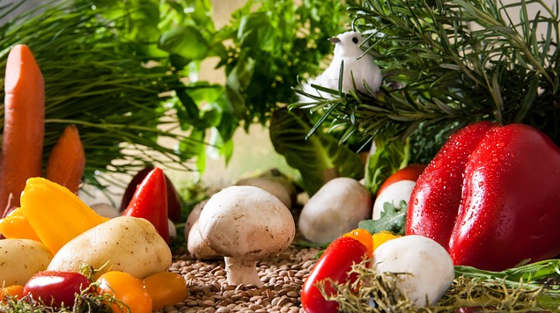


What is Harvest Festival?
What do you already know?

Slide 3

The Creation Story
Let’s go back to the beginning.
This is the story that Christians (and Jews and Muslims) tell each other to explain how the World was made.

Slide 4
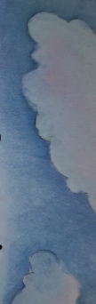
The Bible Story

Slide 5
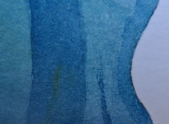
The Bible Story

Slide 6

The Bible Story

Slide 7
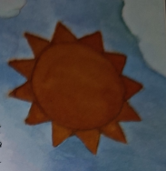
The Bible Story

Slide 8
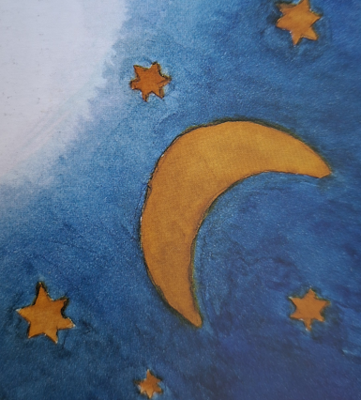
The Bible Story

Slide 9
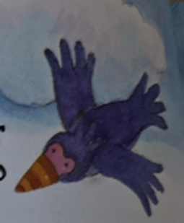
The Bible Story

Slide 10
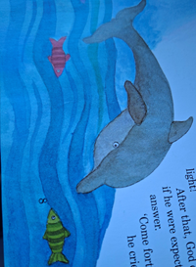
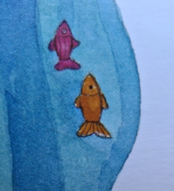
The Bible Story

Slide 11
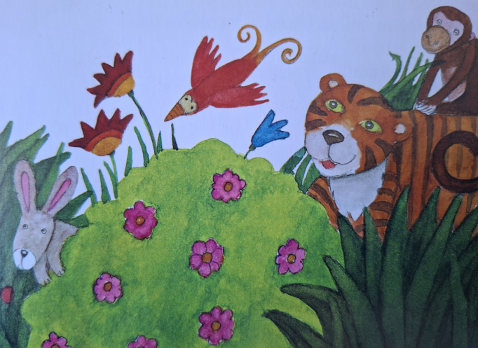
The Bible Story

Slide 12
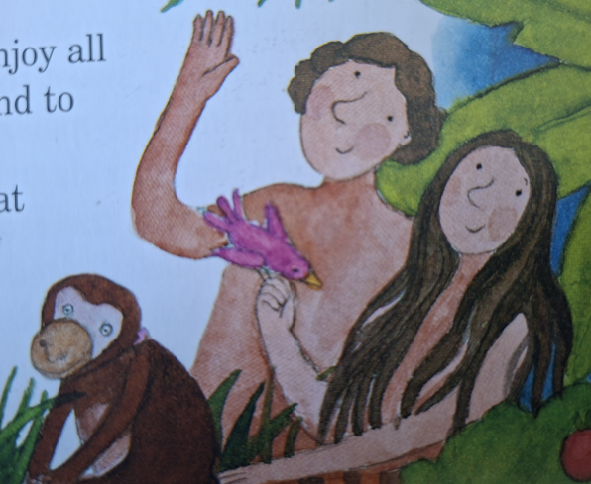
The Bible Story

Slide 13
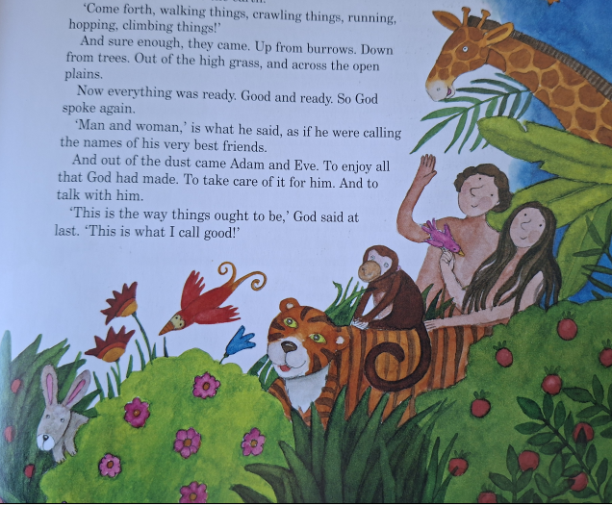
The Bible Story

Slide 14
The Bible Story
Later in the bible, God gives his people these messages:
Celebrate the Festival of Harvest with the first fruits of the crops you sow in your field.
Celebrate the Festival of Ingathering at the end of the year, when you gather in your crops from the field.
Exodus 23:16
When you are harvesting your crops and forget to bring in a bundle of grain from your field, don’t go back to get it. Leave it for the foreigners, orphans and widows. Then the Lord your God will bless you in all you do.
Deuteronomy 24:19

Slide 15
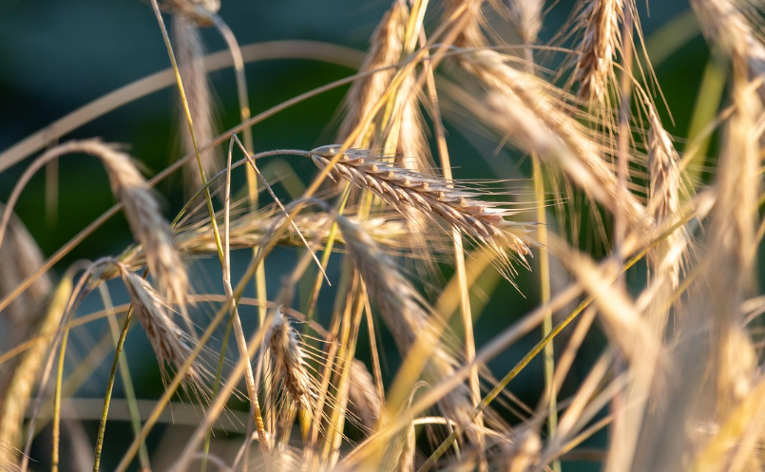
The Bible Story
As Christians, we believe that just as God wants us to look after the world, he also wants the world to sustain (look after) us. This is why we want to say “Thank you” to God for all the food he gives us. This happens at harvest time.
We also believe that there should be enough for everyone, which is why at harvest time when we have plenty of food, we try to share it with those who have less than us.
But how did it all begin?

Slide 16
The First Harvest Festival
A story from Cornwall
A long time ago, in a little village by the sea called Morwenstow, there lived a kind and curious vicar named Reverend Hawker. He wore bright clothes, loved poetry, and had a big heart for people and animals
Rev. Hawker was no ordinary vicar. He wore a pink hat, a bright cloak, and sometimes even a
yellow horse blanket! He built a tiny hut on the cliffs where he wrote poems and watched the
sea.
He loved animals too. One day, he even told off his cat for chasing birds on a Sunday!
But he was also very brave. When ships crashed on the rocks, he would climb down the cliffs
to help.

Slide 17
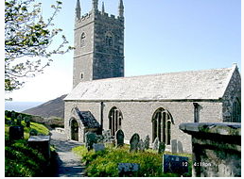
The First Harvest Festival
A story from Cornwall
One autumn, in the year 1843, Rev. Hawker had an idea. He looked at the golden fields of
corn and the baskets of apples and thought, "We should say thank you to God for all this
food!“
So, he invited everyone in the village to come to church. They brought fruit, vegetables, and
bread made from the new corn. The church was full of colour and the smell of fresh food.
They sang songs, said prayers, and gave thanks for the harvest.
This was the very first Harvest Festival in England!
Morwenstow Church

Slide 18
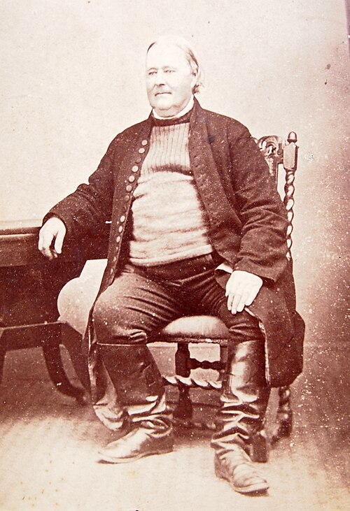
The First Harvest Festival
A story from Cornwall
Rev. Hawker’s Harvest Festival was such a good idea that other churches started doing it
too. Now, every autumn, people all over the country bring food to church or school to say
thank you, just like they did in Morwenstow. The food all goes to people or places that need it, such as charities or foodbanks.
And it all began with one kind vicar, a little Cornish village, and a big idea to say thank you.

Slide 19
Some Fun Facts
Harvest comes from the old English word haerfest which means Autumn.
In Britain, Harvest is celebrated by singing, praying and decorating churches with fruit and food.
It is celebrated to remind Christians to thank God for all the good things He has given them.
In the past, farmers gathered their crops in the autumn because it was not so easy to find food in the winter.
Harvest Festival services usually take place on the Sunday closest to the Harvest full moon.

Slide 20
To Finish
Finally, let’s watch this short film
The story of Bread (youtube.com)
Why is bread so important?
Why is it important to Christians?
Christians share bread at special services called communion.
Would you like to share some bread with me?
Let’s sing Harvest Samba
With grateful thanks to Tina Venton of the Carnmarth South Deanery for her hard work and generosity in sharing these materials.

Slide 21

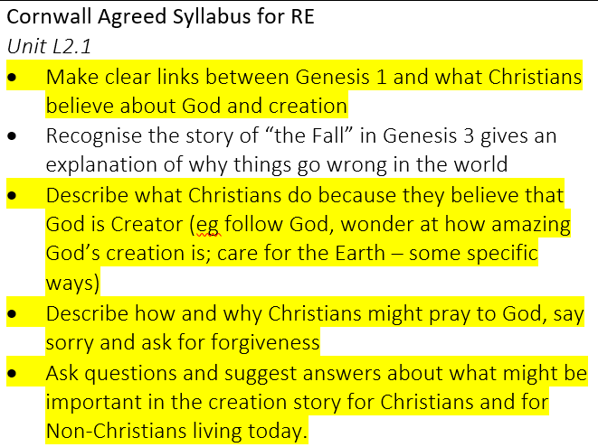
Schools’ Creation Care Workshops
This workshop is designed to cover the LKS2 unit L2.1 from the Cornwall Agreed RE Syllabus. It also ties in with the National Curriculum for history
If there are any other areas of the Cornwall Agreed Syllabus for RE that you would like assistance with, your local church would be happy to help. Please contact your church directly, or email Clare Green (Schools’ Creation Care Officer) on clare.green@truro.anglican.org
National Curriculum for History
A local history study
a depth study linked to one of the British areas of study listed above
a study over time tracing how several aspects of national history are reflected in the locality (this can go beyond 1066)
a study of an aspect of history or a site dating from a period beyond 1066 that is significant in the locality

