Slide 1

Creation Care
Champions
A project allowing schools to work in partnership with their local churches in learning about how Christians strive to steward God’s creation.

Slide 2
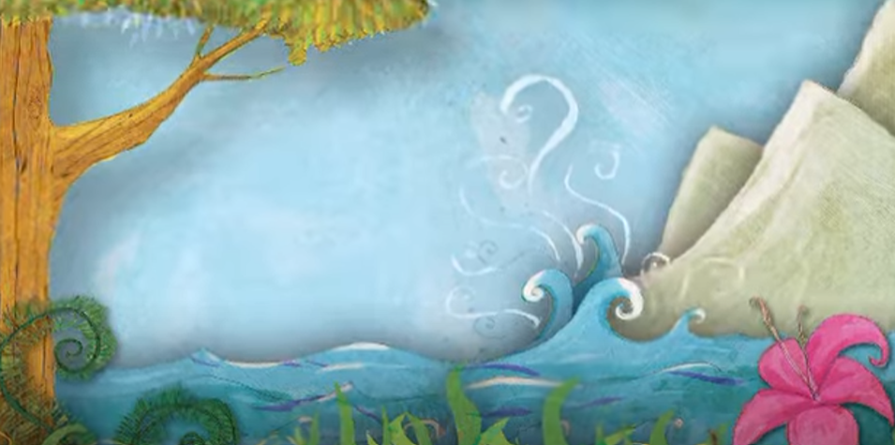

The Creation Story
This is the story that Christians (and Jews and Muslims) tell each other to explain how the World was made.

Slide 3
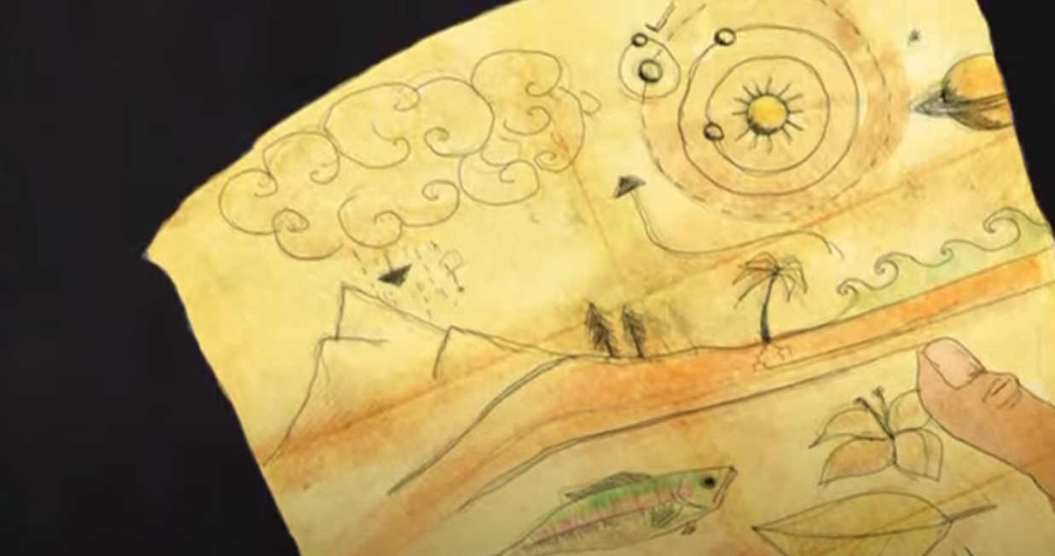

Slide 4
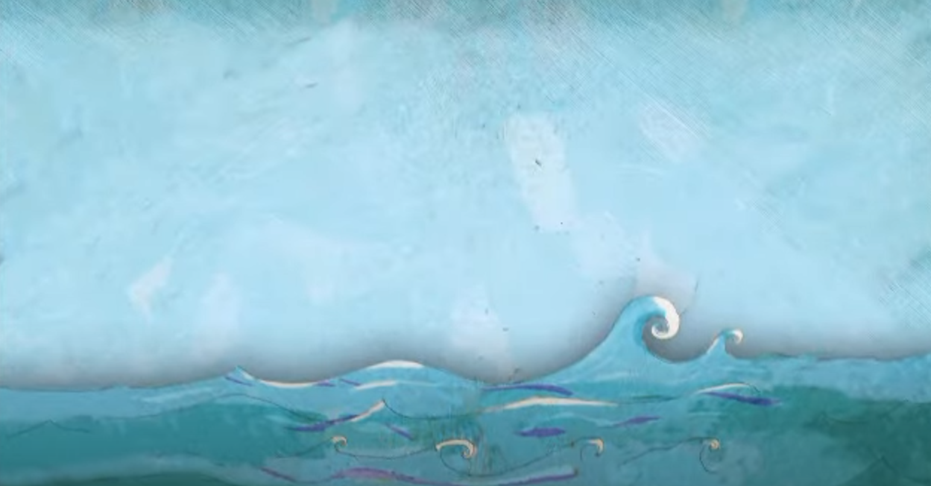

Slide 5
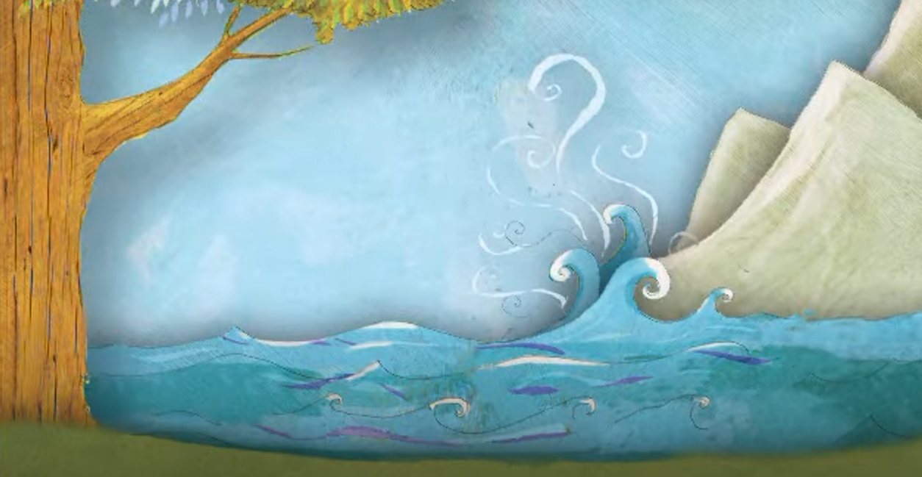

Slide 6
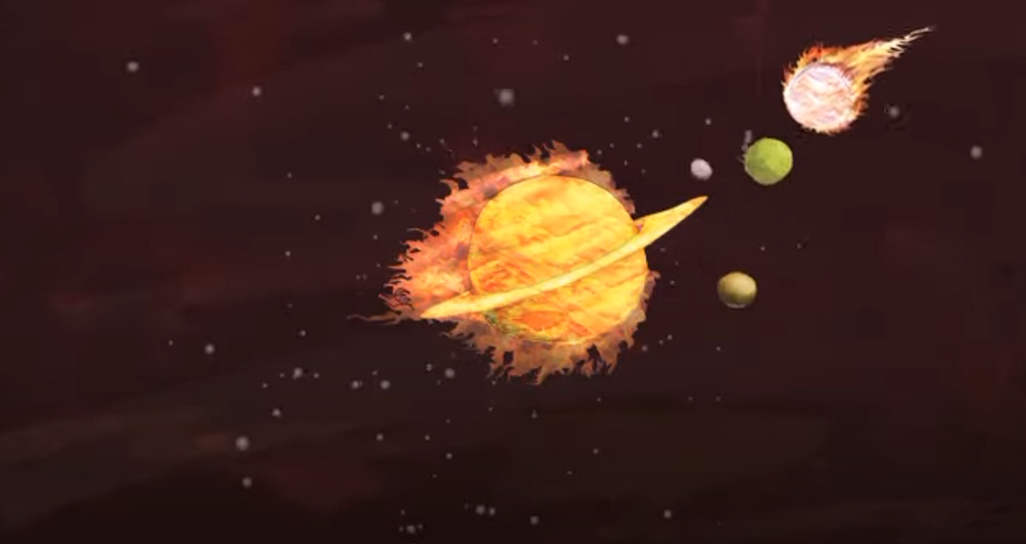

Slide 7
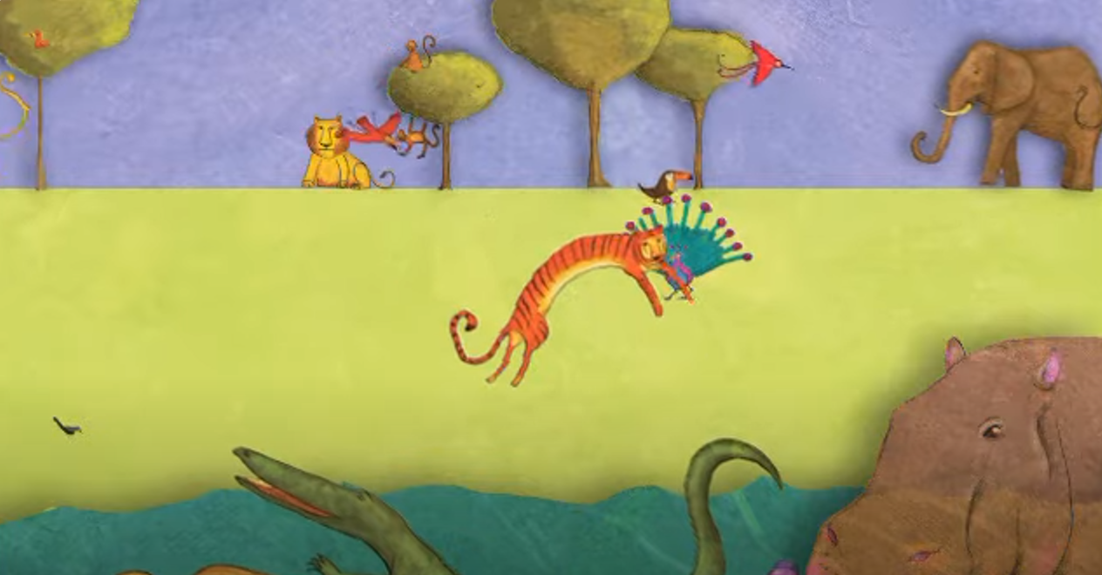

Slide 8
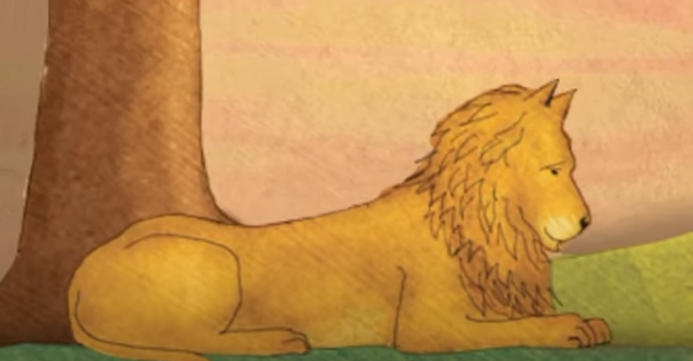

Slide 9
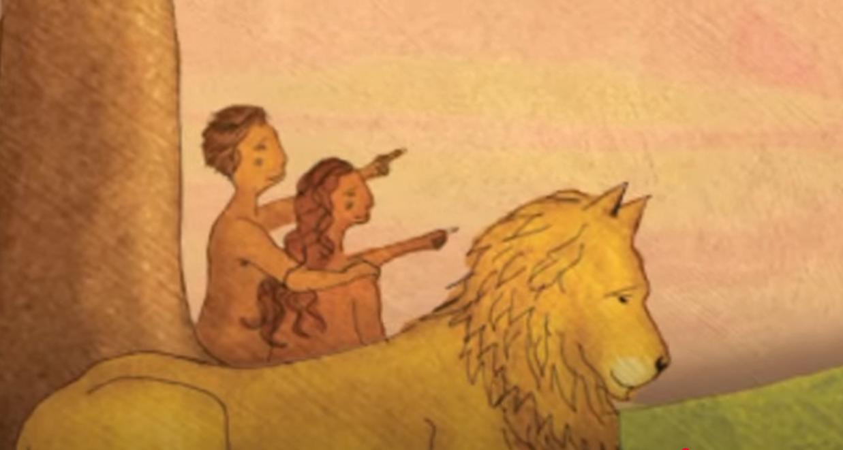

Slide 10
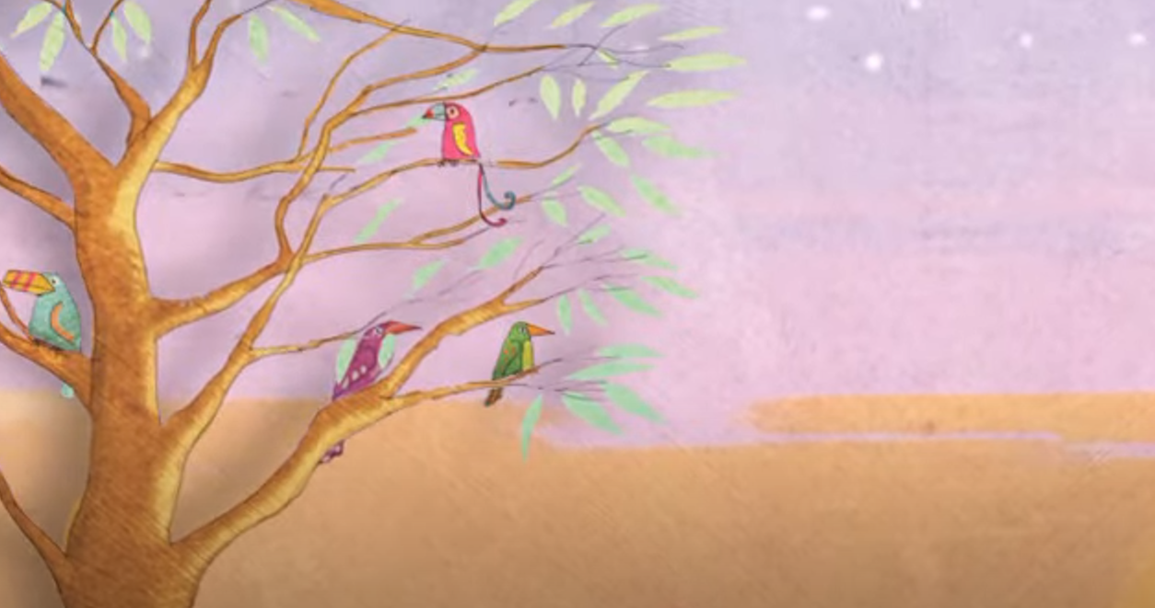

Slide 11
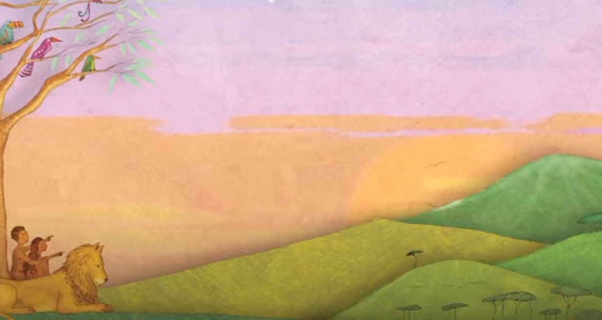

Slide 12
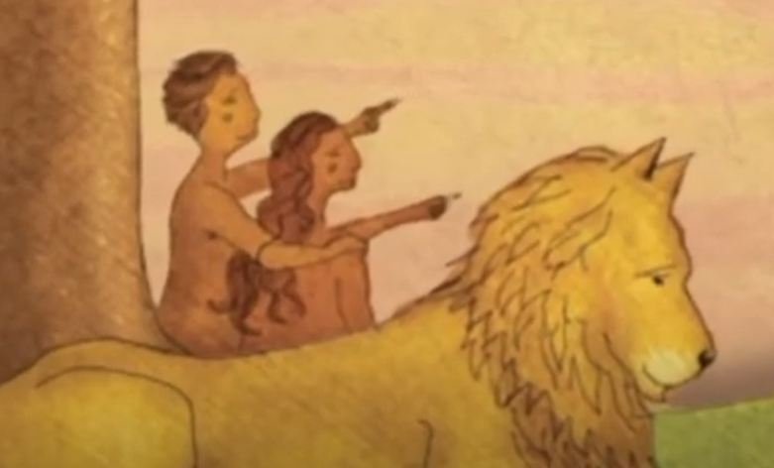

Why did God create people?
In this story, God tells us one of the reasons why He made people, this is how one translation of the bible puts it.
God spoke: “Let us make human beings in our image, make them
reflecting our nature
So they can be responsible for the fish in the sea,
the birds in the air, the cattle,
And, yes, Earth itself,
and every animal that moves on the face of Earth.”

Slide 13
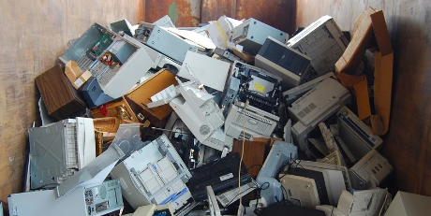
How well have we done?
Christians believe that part of the reason why human beings were put on Earth by God, was to look after his creation. They call this stewardship. That means that we are responsible for the Earth and all that is on it.
Have we been good stewards of the planet?

Slide 14

How well have we done?
Churches like this one are doing their best to be good stewards of God’s creation. They are trying to:
Cherish creation
Cut carbon
Speak up
Thank you for coming to help!
This morning you are going to take part in some activities connected with these aims.
Are you ready to be a good steward?

Slide 15

To Finish
Finally, you all have a leaf made of paper. Please write your wish for the planet on your leaf. If you wish to make your wish into a prayer start with “Dear God” and finish with “Amen”
When you have finished, come and stick it on our tree. On Sunday, when they come to church, the congregation of this church will pray your prayers and add prayers of their own.
Click on the Leaf to sing together.

Slide 16
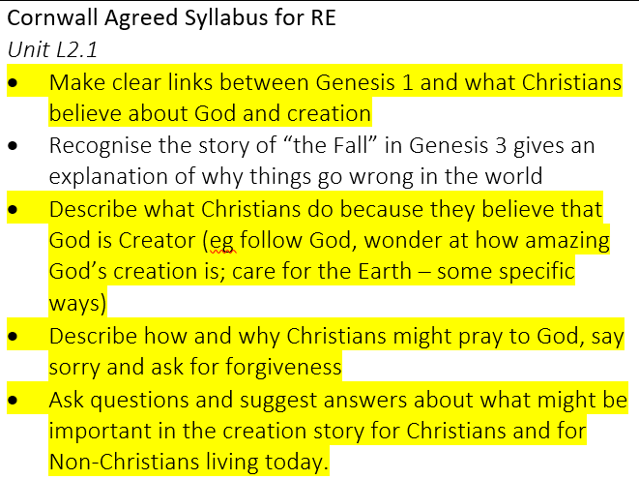
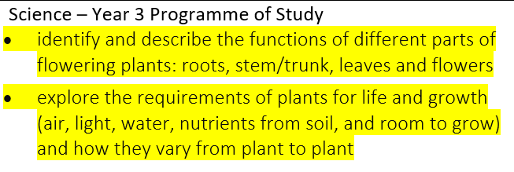
A bit for teachers…
This workshop is designed to cover the LKS2 unit L2.1 from the Cornwall Agreed RE Syllabus. It also ties in with the National Curriculum for science.
If there are any other areas of the Cornwall Agreed Syllabus for RE that you would like assistance with, your local church would be happy to help. Please contact your church directly, or email Clare Green (Schools’ Creation Care Officer) on clare.green@truro.anglican.org

