Slide 1
Transport Survey
Transport/LKS2/Maths

Slide 2
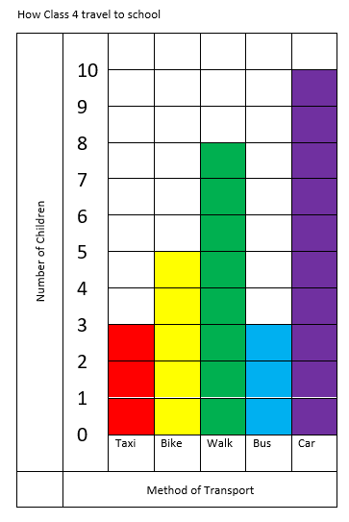
Transport Survey
Look at the bar chart below, what does it tell you?

Slide 3
Transport Survey
Work with a partner to answer the questions.
What is the most popular way of getting to school in this class?
How many children use a public form of transport?
How many children come to school using their own energy to travel?
How many children are there in Class 4?

Slide 4
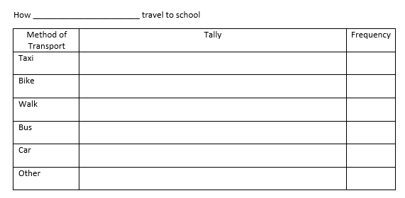
Transport Survey
You are now going to compare Class 4 with your own class, to do this you need to make a bar chart of your own. Start by helping your teacher to complete this tally chart.
Now use the information to make a bar chart.

Slide 5
Transport Survey
Work with a partner to answer the questions again, using your own bar chart.
What is the most popular way of getting to school in this class?
How many children use a public form of transport?
How many children come to school using their own energy to travel?
How many children are there in your class today?

Slide 6
Transport Survey
Work with a partner to answer the questions again, using your own bar chart.
What is the most popular way of getting to school in this class?
How many children use a public form of transport?
How many children come to school using their own energy to travel?
How many children are there in Class 4?
Compare the two charts, what similarities and differences can you see? Talk to your class about these.

Slide 7
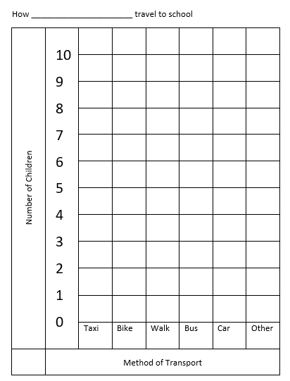
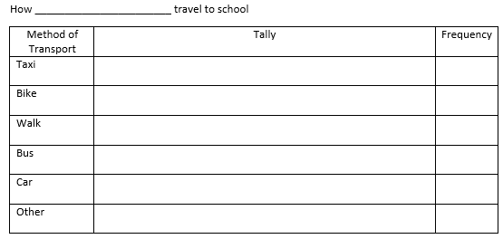
Resources

Slide 8
Resources

Slide 9
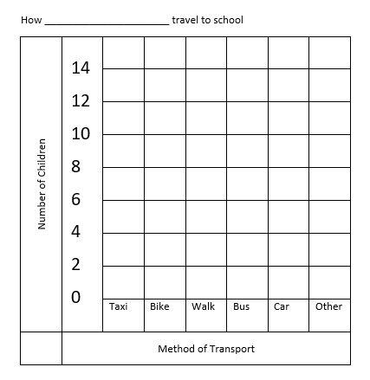
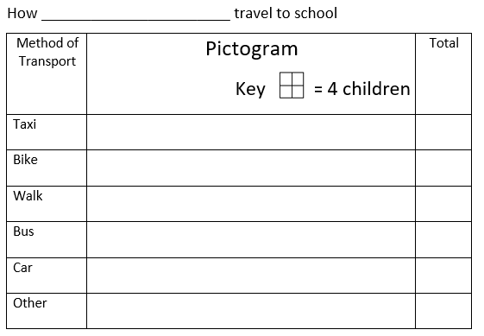
Resources

