Slide 1
What is an Eco-School?
A resource for collective worship explaining the Eco-Schools scheme to children.

Slide 2
Quick Quiz
Can you answer these questions about the very first bible story?
What is the name of the first book in the bible?
What did God create first?
On which day did God create people?
Genesis
Light
The sixth day
Notes:
This can be used as a quick quiz, or before or after reading the Genesis story if you wish to include that.

Slide 3
Why did God create people?
In this story, God tells us one of the reasons why He made people, this is how one translation of the bible puts it.
God spoke: “Let us make human beings in our image, make them reflecting our nature So they can be responsible for the fish in the sea, the birds in the air, the cattle, And, yes, Earth itself, and every animal that moves on the face of Earth.”
Genesis 1: 26-7
Notes:
A pupil could read this aloud. This is the message version.

Slide 4
Why did God create people?
God spoke: “Let us make human beings in our image, make them reflecting our nature So they can be responsible for the fish in the sea, the birds in the air, the cattle, And, yes, Earth itself, and every animal that moves on the face of Earth.”
Genesis 1: 26-7
What do you think the word responsible means?
What do you think God meant ?
Notes:
Ask the questions and allow for thinking time, paired talk etc and then take feedback.

Slide 5
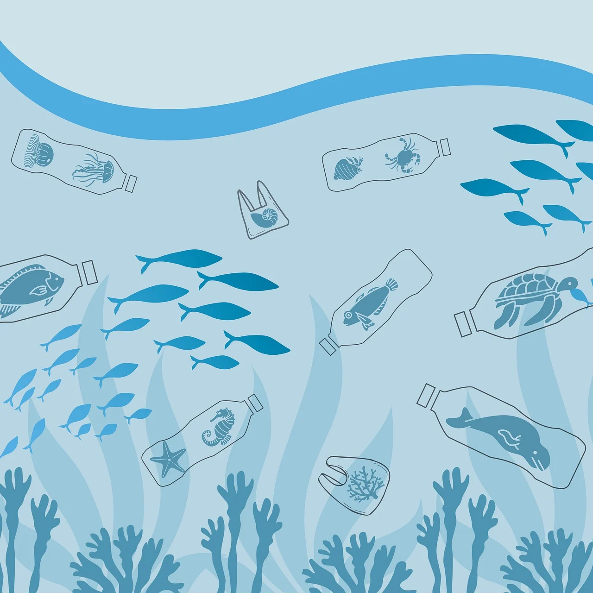
Have people done a good job?
Hold up your fingers to show how many marks out of ten you would give the human race for looking after the planet.
What can we do to help?
Notes:
Pupils will hopefully respond with ideas about not dropping litter, saving energy or water etc.

Slide 6
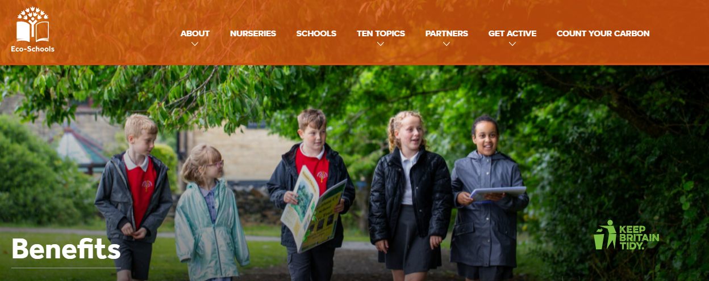
Introducing Eco-Schools
Eco-Schools is a scheme that helps young people to help the environment, starting in our very own school!
Working together as a team, led by our very own Eco-Committee, we are going to try this year to improve the impact we have on the planet. By doing this, we can earn a Green Flag Award.

Slide 7
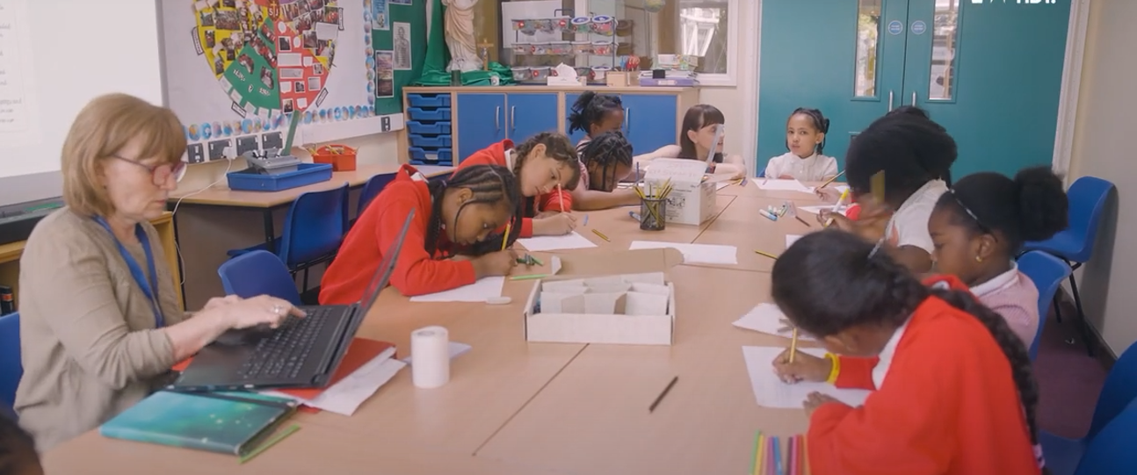
What is an Eco-Committee?
An Eco-Committee is a group of young people who want to make their school more sustainable. They have to be prepared to give up their time, share their ideas, listen to others and encourage their classmates and the school’s adults to make changes.
What kind of person would make a good Eco-Committee member?
Notes:
Allow for responses.

Slide 8
What is an Eco-Committee?
Do you think you would be a good Eco-Committee member?
Here is what we are going to do………
Notes:
Click on the picture to run a short video, then explain how the Eco-Committee is going to be organised in your setting.

Slide 9
Let us pray…
Father God,
Thank you for the amazing world that you have given to us, we are sorry for the part we have played in not caring for it as well as we should.
As we set out on this journey to obey your command to “be responsible”, help us to think carefully, work together and make good decisions. Help us to be good stewards of your beautiful Earth,
In Jesus’ name,
Amen.

