Slide 1
A quick guide to Parochial Fees
Treasurers Training 2024

Slide 2

Content of session
What are Parochial Fees?
PCC and DBF fee
How to submit DBF fee
How to account for fees
Questions

Slide 3
What are Parochial Fees?
Parochial fees are the required (legally payable) fees for weddings, baptisms and funerals
For some of you these may be administered centrally so you may not be involved with them at a parish level

Slide 4
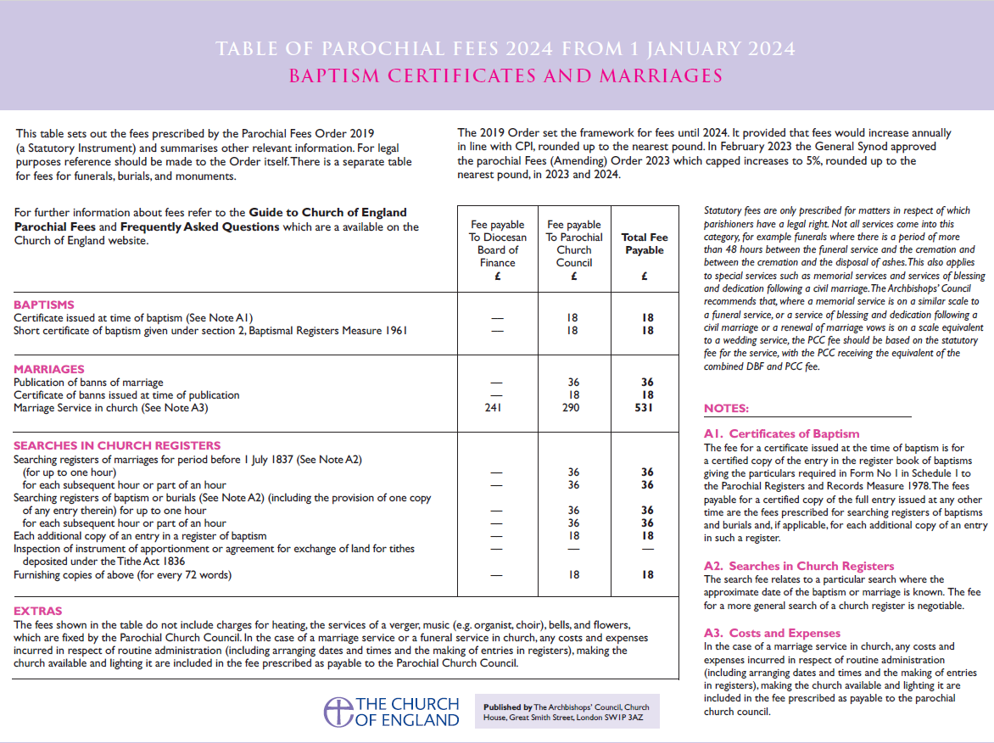

Slide 5
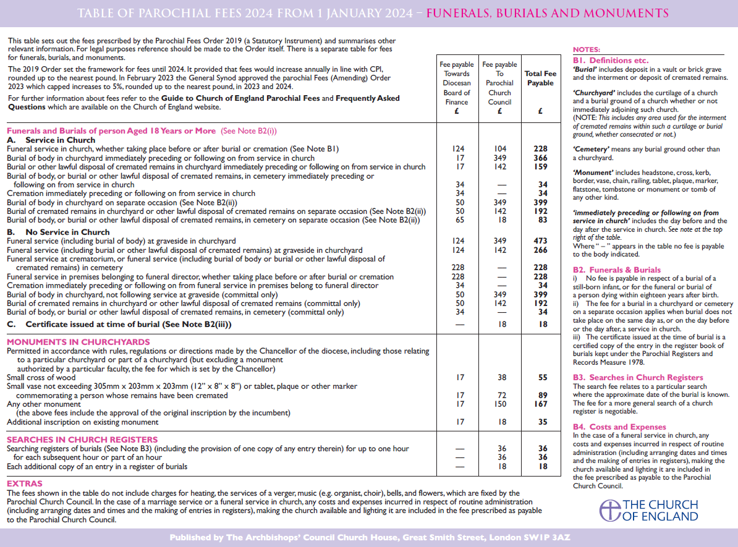

Slide 6
Fee payable to Parochial Church Council
Parochial fees do not include payment for “extras”, which must be optional. For example:
Heating
The services of a verger
The services of an organist, choir or bell-ringers
Sheet or recorded music that has to be specially purchased
The provision of recorded or taped music
The taking of films, video or sound recordings (where permitted)
Flowers
Special furnishings

Slide 7
Fee payable to Diocesan Board of Finance
Minister in receipt of a stipend
100% to DBF
Part time minister in receipt of a stipend
50% to minister
50% to DBF
Any minister (ordained or Reader) who is not in receipt of a stipend, (self supporting & retired stipendiary)
80% to minister
20% to DBF

Slide 10
How to account for Parochial Fees
Recommended that fees are paid to the PCC
As the PCC is acting as the intermediary, the following elements should not be included in the year end financial statements:
  Fees passed in full to bell ringers, organists, vergers, choir, etc.
  Fees passed on to the Diocesan Board of Finance
  Part fees passed on to retired clergy
‘Extra’ charges retained by the PCC should be posted as PCC income

Slide 11
Service Fees
Only retired stipendiary clergy are entitled to a fee, when ministering outside their usual place of worship. The fees payable are
£30 for a service with a sermon
£15 for a second service or one without a sermon
Fees earned in any one week, remain a maximum of £60
These fees should be met from the PCC's funds.

Slide 12
Website Links
Finance section of the diocese website:
https://trurodiocese.org.uk/resources/parish-facing-support/finance/
Parochial section of the diocese website:
https://trurodiocese.org.uk/resources/parish-facing-support/finance/parochial-fees/

Slide 13
Any questions?

Slide 14

Contact us
The Truro Diocesan Board of Finance Ltd
Old Cathedral School
Cathedral Close
Truro
TR1 2FQ
Telephone 01872 274351
Email finance@Truro.anglican.org
Website www.trurodiocese.org.uk

