Slide 1
Children, Young People and Schools in the Pandemic
Katie Fitzsimmons
Diocesan Director of Education
CCLI: 553903

Slide 2
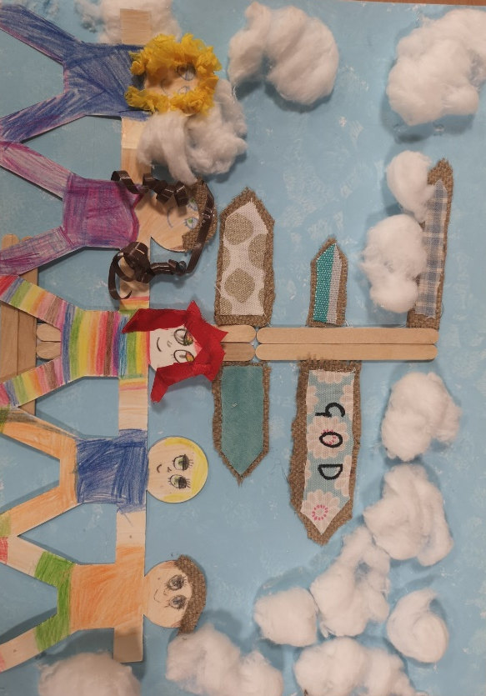
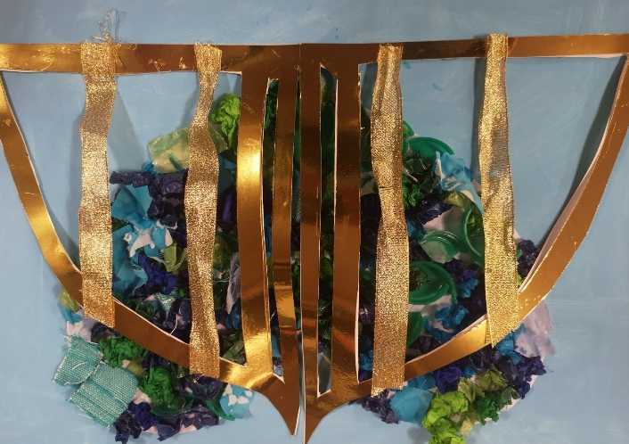
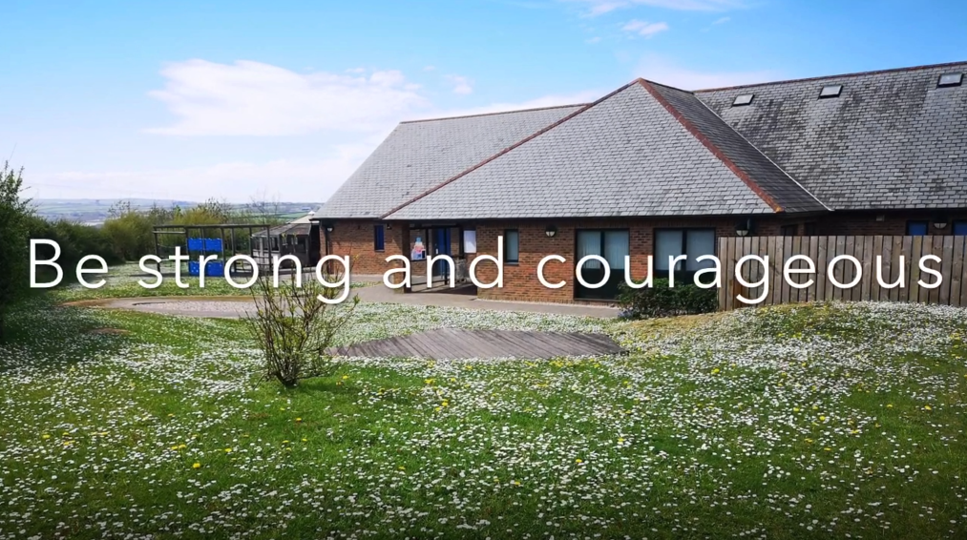
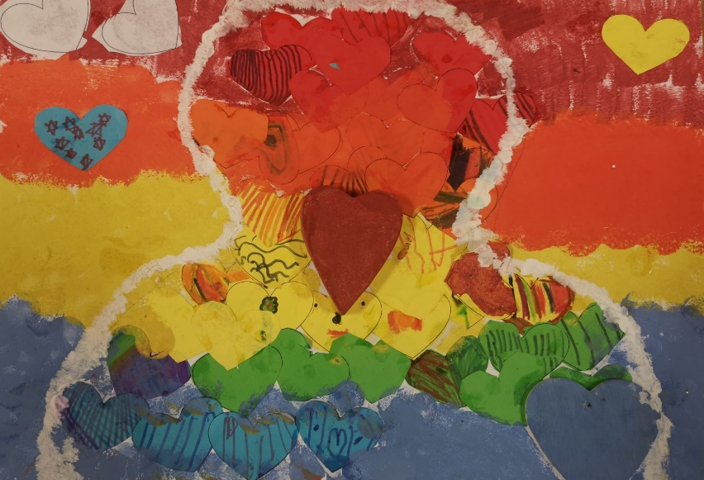
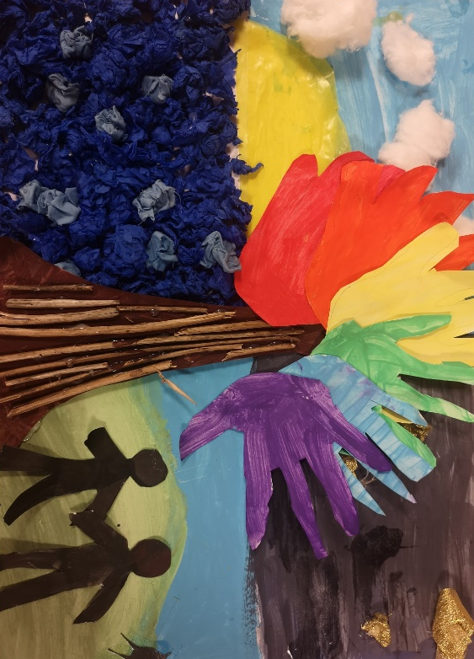
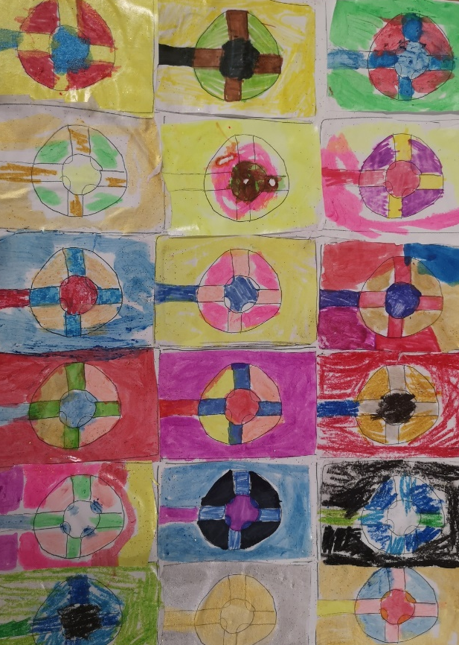
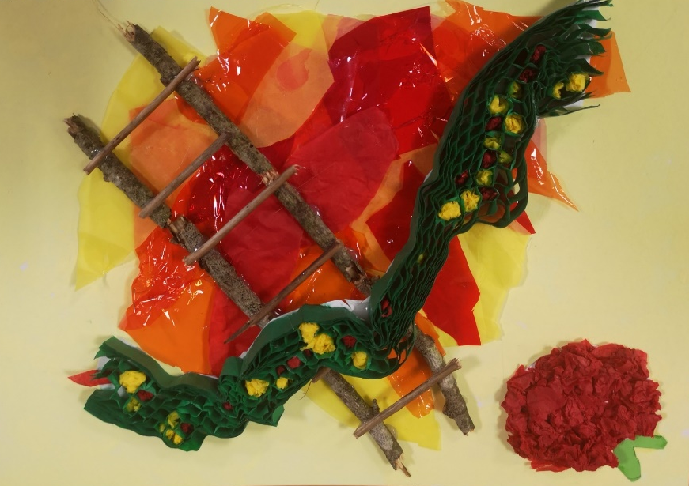
St Issey C of E School

Slide 3
St Issey C of E School
I haven't been to school for a long time and I still need to learn things, like morning Maths and English, some of my friends were learning at home and some were learning in
school.
It was important to play with my friends when we went back to school and it was lovely to keep in touch when we were home schooling"
St Issey School have been amazing with the food packages
Why has school been important during the 'Lock down'?
Because it meant I was still hearing from my friends and my education wasn't at a full stop.
We loved keeping the connection with staff-especially story time. I think it's made the thought of going back less daunting. Great to have activity ideas too.
To provide extra support with activities and learning. Also keeping a connection to staff and nursery.

Slide 4
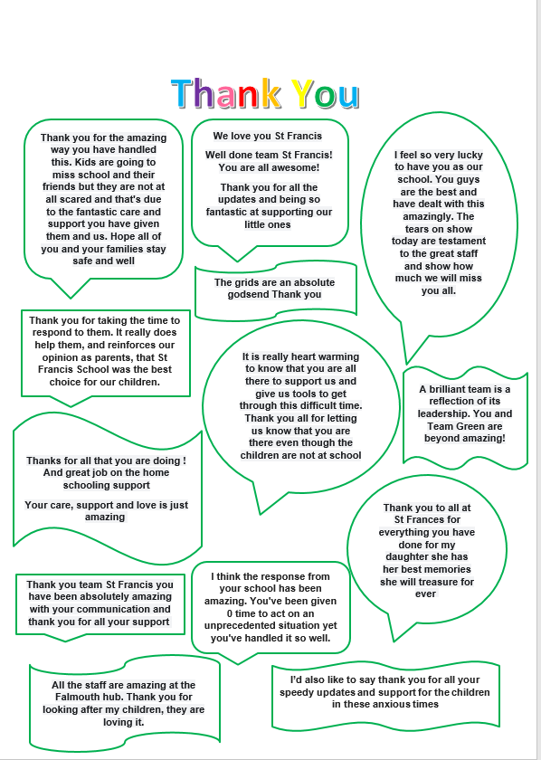
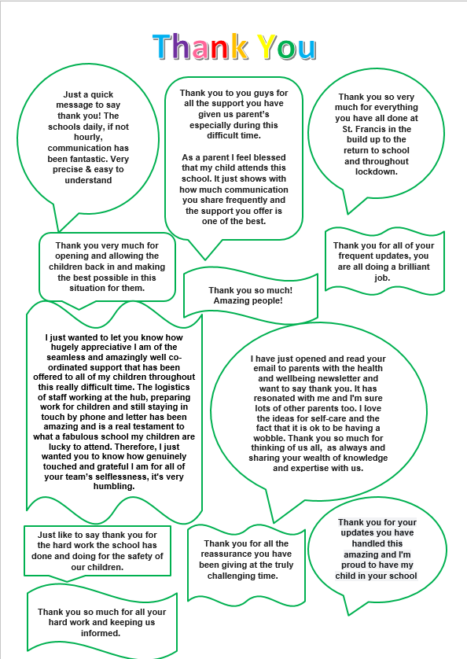
St Francis C of E School

Slide 5
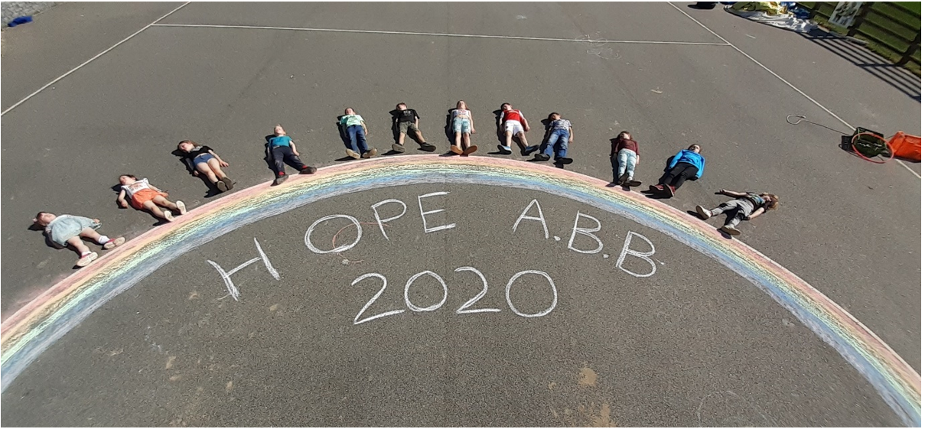
Archbishop Benson C of E School

Slide 6
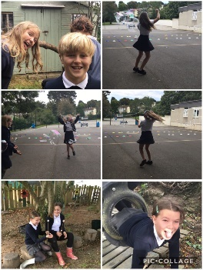
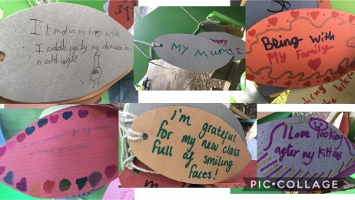
St Mary’s C of E School
Gratitude work by Y5 on return to school
98.7% attendance on first day back
Children have confidently returned to school

Slide 7
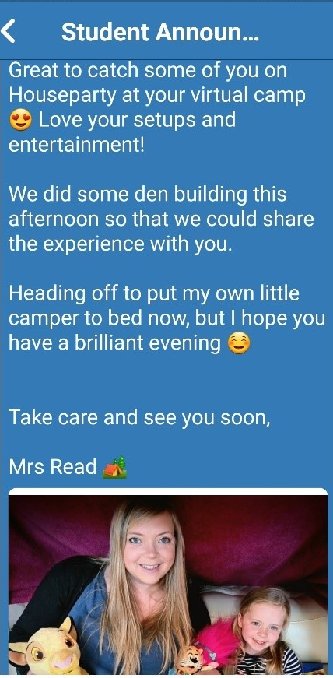
St Mary’s CofE School - Truro
A Y6 child shared how she had planted seeds in her garden to encourage bee friendly flowers
A ‘thank you’ from a staff member which quotes - ‘You put the SAINT in St Mary’s’
One of our older pupils baked goodies for a tea party and donated them to charity for VE Day.

Slide 8
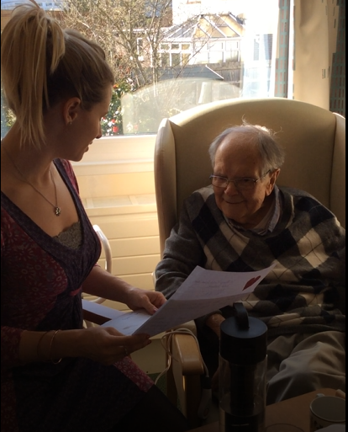
St Mary’s C of E School - Truro
Before school closed, children wrote letters to the local care homes where we are regular visitors (for singing at Christmas, etc.). Children were saddened that the residents could no longer receive visitors, so wrote letters to let them know they were in their thoughts. Mrs Spencer shared one with her Grandad and made a video to show the children. We received feedback from the manager and personal letter from a resident.

Slide 9
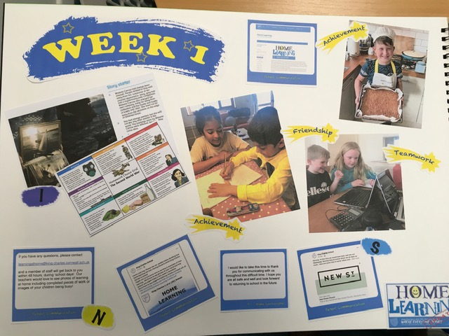
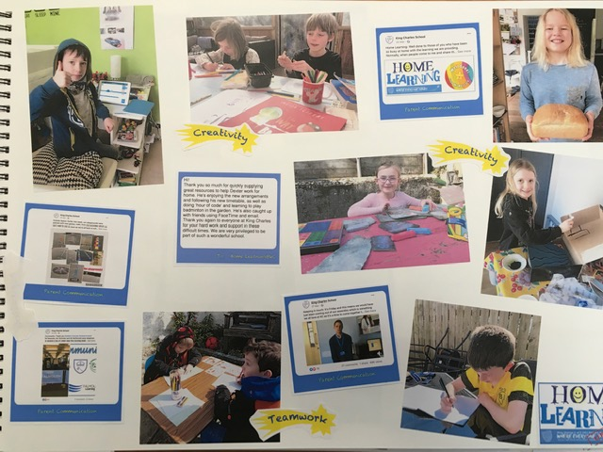
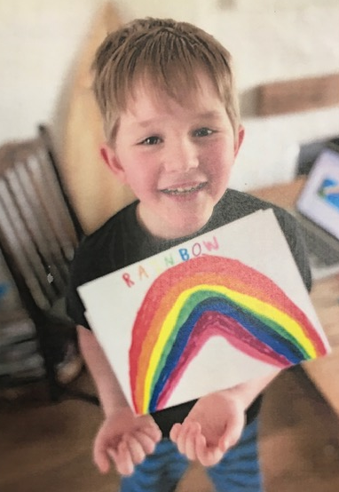
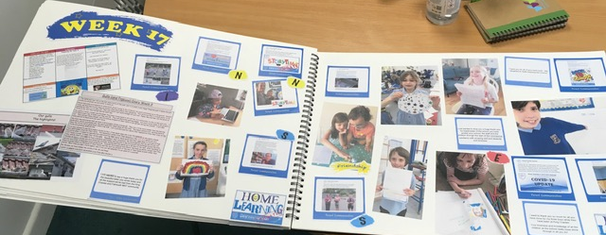
King Charles C of E School

Slide 10
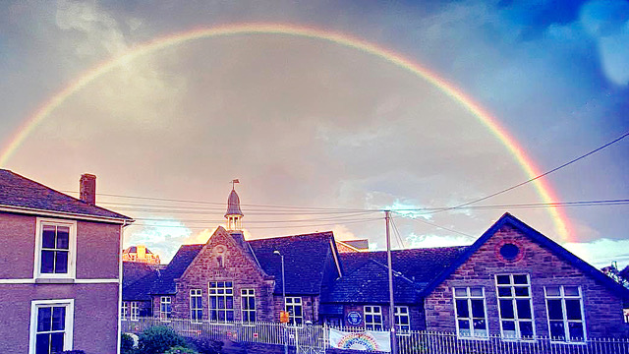

Slide 11
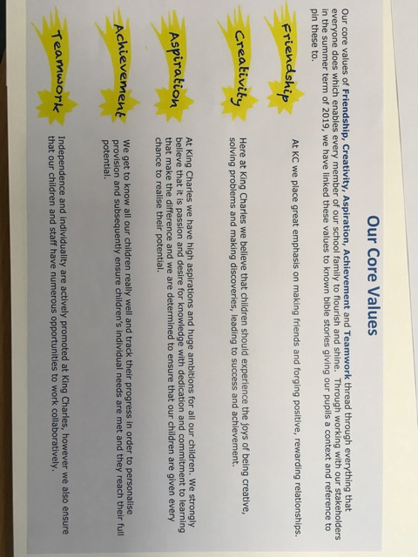
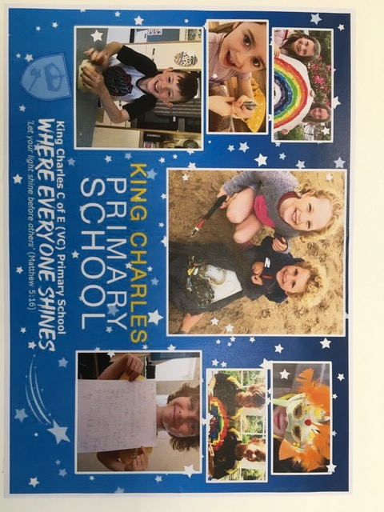

Slide 14
Group Discussion
Given what we have seen and heard today… - what surprised and / or shocked you? And, if we see children and young people as a priority… - what will we pray for? - what will we do?

