Slide 1
Extravagant Worship

Slide 2
Extravagant Worship
Worship = Worth- ship
‘I come towards to kiss.’
‘Worship is to feel in the heart, and to express in some appropriate manner, a humbling but delightful sense of admiring awe and astonished wonder.’ [A.W. Tozer]
‘Worship is about intimacy with God. Worship is the act of freely giving love to God (it forms and informs every activity of the Christian’s life). Worship is also an expression of awe, submission and respect towards God’ [John Wimber]
‘Worship is to quicken the conscience by the holiness of God, to feed the mind with the truth of God, to purge the imagination by the beauty of God, to devote the will to the purpose of God.’[William Temple, 20th century Archbishop of Canterbury]
‘Worship is our response both personal and corporate to God, for who he is and what he has done, expressed in and by the things we say and the way we live.’[Louie Giglio]

Slide 3
Extravagant Worship
I appeal to you therefore, brothers and sisters, by the mercies of God, to present your bodies as a living sacrifice, holy and acceptable to God, which is your reasonable worship [Romans 12:1]
Luke 7:36-50

Slide 4
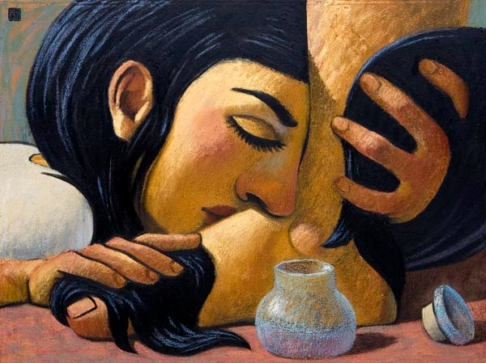
Extravagant Worship
Anointing His Feet by Wayne Forte © (used with permission)

Slide 5
Extravagant Worship

