Slide 1
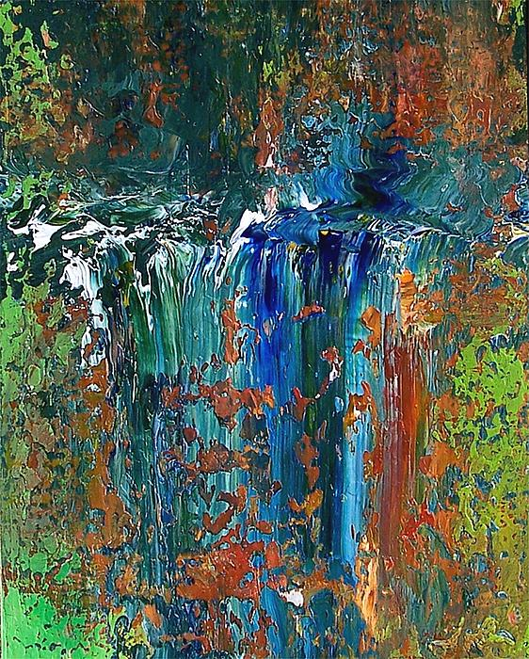
The Great Commission
by
John Larson

